Slide 1

*Insert logo here
Creating a Tax Efficient
Retirement
This material is provided courtesy of *Insert Firm Name* and contains general information to help you understand financial planning strategies.
Notes:
- Number one expense.
- Control what we can control to max what you have worked so hard to save.

Slide 2
Throughout the presentation, we may generally discuss different financial vehicles; however, nothing I say should be construed as a recommendation to buy or sell any financial vehicle, nor should it be used to make decisions today about your investments.
My goal with this presentation is to expose you to ideas and financial vehicles and strategies that may help you work toward your financial goals. Please understand that I cannot make any promises or guarantees that you will accomplish such goals. All investments are subject to risk, including the potential loss of principal. No investment strategy can guarantee a profit or protect against loss in periods of declining values.
Any references to protection benefits generally refer to fixed insurance products. Insurance and annuity product guarantees are backed by the financial strength and claims-paying ability of the issuing insurance company.
This presentation is designed to provide general information on the subjects covered. It is not, however, intended to provide specific legal or tax advice and cannot be used to avoid tax penalties or to promote, market or recommend any tax plan or arrangement. Please note that *Insert Firm Name* and its representatives do not give legal or tax advice. You are encouraged to consult your tax advisor or attorney.
Advisory services offered by *Insert Firm Name*, a Registered Investment Advisory firm. Registration does not imply a certain level of skill or training. The information on this website is not intended as tax or legal advice. Please consult legal or tax professionals for specific information regarding your individual situation.
Despite efforts to be accurate and current, this presentation may contain out-of-date information; we are under no obligation to advise you of any subsequent changes related to the topics discussed in this presentation.
At the end of the seminar/webinar, you will be provided an opportunity to visit with us one-on-one to discuss your specific circumstance in a private, comfortable setting. There is no obligation to you for this visit. At this visit you may be provided with information regarding the purchase of insurance or investment products or establishing an advisory relationship.
*Insert Firm Name
DISCLAIMER
This material is provided courtesy of *Insert firm name* and contains general information to help you understand financial planning strategies.
DISCLAIMER
*Insert Logo

Slide 3
*Insert Name
CFA®, CFP®, etc.
Todays Presenter
Insert info about you and your firm’s background and your hobbies, qualifications, motivators, etc.
*Insert Photo of Yourself
*Insert Name
Senior Wealth Advisor
Notes:
- Unique time → Gallop polls have made your generations greatest fear no longer dying but outliving your money.
- The stock market is best wealth accumulation tool ever devised.
- We’ve got some secrets to helping you stay solvent, avoid some big mistakes and a special offer for you for those who stick with me through this.

Slide 4
Taxes
Income
Navigate tax complexities with ease. We help you minimize liabilities and maximize savings, ensuring you keep more of your earnings.
Boost and secure your income. We offer strategies for investments, retirement, and passive income to support your lifestyle.
Helping You Live Your Best Life
Plan
Medical
Plan for healthcare expenses. We guide you through insurance options and potential costs, securing your financial health.
Risk
Mitigate financial risks. Our strategies protect your assets and prepare you for the unexpected, ensuring stability and peace of mind.
*Insert Logo Here
Notes:
Taxes are not the only thing that matters but they are the largest expense for most people. Tax strategy → 3-5 strategies selected for your situation to reduce lifetime tax burden. Income plan → call it an income map. Manage risk → compensated for the level or risk you take.

Slide 5

Avoidable Tax Costs
$280,000
30%
Lifetime Overpayment
Potential Savings
Average American household pays over $280,000 in unnecessary income taxes during their lifetime.
With proper planning, many retirees could reduce their tax burden by nearly a third.
$11,000
Annual Impact
This equates to approximately $11,000 annually over a 25-year retirement period.
Notes:
- Not an extra check to the IRS
- Put more money your pocket

Slide 6
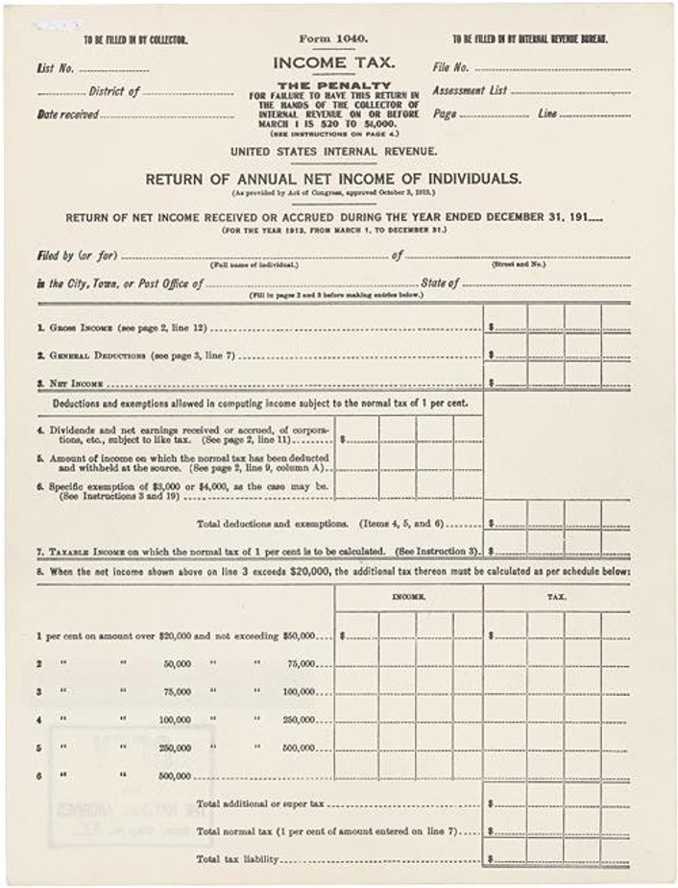
First Tax return
4
Pages
*Insert Logo Here
Notes:
The return and all the instructions that came with it were 4 pages long! Top rate was 7%!

Slide 7


IRS Rules
83,000 Pages
27 Feet High
*Insert Logo Here
Notes:
War and peace is 1200 pages long… this is 70 times as long. Just a few months ago the IRS published another 275-page discernment on the secure act, changing the way this law is interpreted which was passed just a few years ago!!! The secure act is extremely important for you to understand though folks – it’s the biggest change to distribution math and retirement accounts in our country's history! Secure act 2.0 – moved RMD to age 73 and age 75 if your 75 in 2035 or later. Lots of changes – know these.
Is extending the RMD age out a good thing or a bad thing? These folks are going to pay at least 18% more during their tax lifetime.

Slide 8
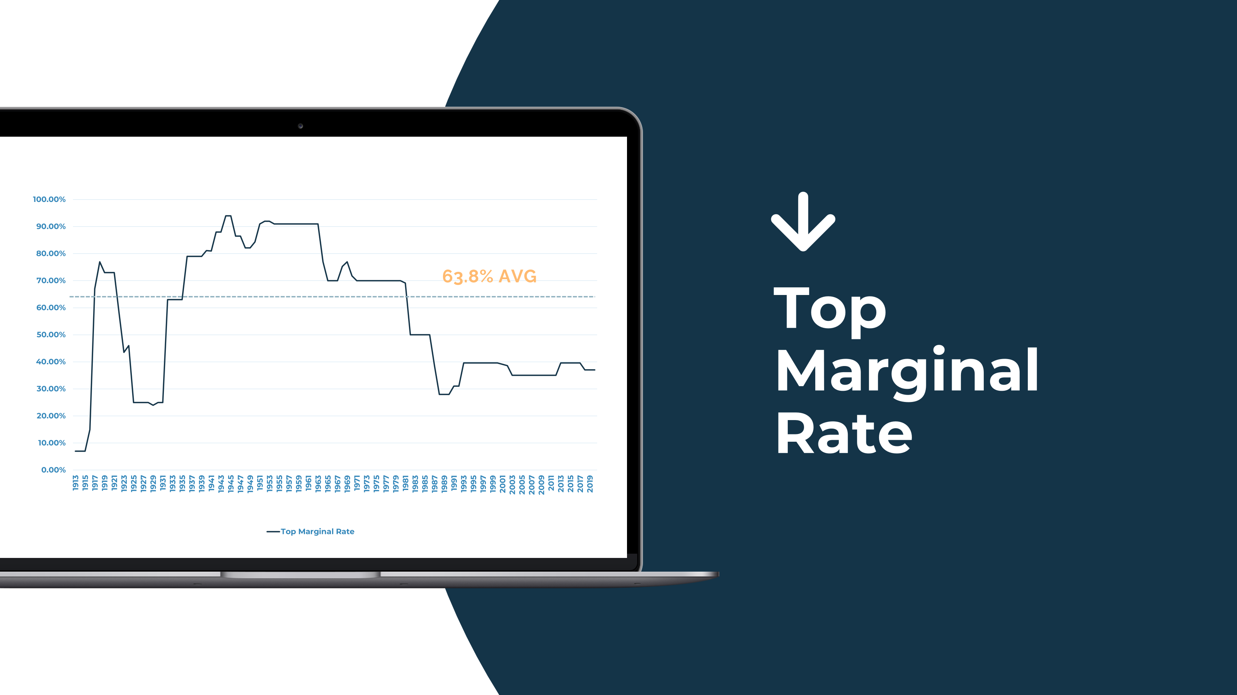
Types of Accounts
Tax-Deferred
Taxable
Tax-Free
Pay taxes later when you withdraw funds.
Pay taxes annually on interest, dividends, and capital gains.
No taxes on qualified withdrawals.
Roth IRA
401(k), 403(b), 457(A)
Brokerage accounts
Health Savings Account (HSA)
Traditional IRA
CDs and savings accounts
Certain insurance products
Simple and SEP IRAs
Trusts
Cash Balance Pension
Notes:
1915 → WW1 was expensive.
Rebuilding during the roaring 20’s
WW2 + SS/Entitlement spending tax rates up
1946 first time our debt to GDP surpassed 100% (last time until about 6 years ago)
Top tax rate 94% in 1946.

Slide 9
Q:
1940s
Who got hit with the 94% tax bracket?
*Insert Logo Here
Notes:
- Film making
- Former US president.

Slide 10

A:
1940s
Those with $200,000 or more in taxable income
$442K in 1970s money
$3.5M in today’s money
RONALD REAGAN
Source:
Publicity photograph of Ronald Reagan. 1940s.
https://www.reaganlibrary.gov/archives/audiovisual/white-house-photo-collection-galleries/early-ronald-reagan-and-family
*Insert Logo Here
Notes:
Only would do 2 movies @ 100k each. Over 200k then at 94% (+ state).

Slide 11
Q:
1970s
What was the highest marginal tax bracket during the entire decade?
*Insert Logo Here
Notes:
Next era of high tax rates – 70’s (inflation, post Vietnam, high debt).

Slide 12

A:
1970s
70%
Source:
Https://www.taxpolicycenter.org/statistics/historical-highest-marginal-income-tax-rates
Paul Vathis. Ronald Reagan, November 1973.
https://www.wunc.org/2014-08-05/how-ronald-reagan-used-an-invisible-bridge-to-win-over-americans
*Insert Logo Here

Slide 13
Q:
2018-2025
What is the highest marginal tax bracket today?
*Insert Logo Here
Notes:
Current 37%. Half of the 1970’s and 1/3 of 1940s. Where do we go from here…

Slide 14
A:
2018-2025
37%
Source:
Https://www.taxpolicycenter.org/statistics/historical-highest-marginal-income-tax-rates
*Insert Logo Here

Slide 15
Q:
2026 and beyond?
What is going to happen in the future?
*Insert Logo Here

Slide 16

A:
Fiscal Gap Accounting
Economist Dr. Larry Kotlikoff
Projects out what we have promised to pay. And what we can deliver based on our tax rates. That’s our true national debt - 239 trillion…
Source:
Https://www.larrykotlikoff.substack.com
*Insert Logo Here
Notes:
FDIC/SIPC/MBS/PGBC all these promises…

Slide 17












Debt
Medicare
Medicaid
Social Security
The CARES Act
Pensions
Defense
Health Care
Welfare
*Insert Logo Here

Slide 18

Comptroller General of Fed Govt. Chief Auditor Board of S.S.
David Walker
Under bush and Clinton. 1998-2008. Medicare is 5x more expensive than SS. In order to deliver on these promises you will have to double taxes immediately. Resigned in 2008 due to concerns – wrote “come back America” where he diagnosed the problem. Tax rates have to double, or we go broke as a nation.
Source:
https://news.nau.edu/economic-outlook-conference/
*Insert Logo Here
Notes:
- Tipping point → 53 Trillion.
- Entire GDP goes to debt service.

Slide 19

Entitlement programs are a fiscal cancer
In order to keep these promises, tax rates have to double
With no change
in tax rates, the
national debt will
grow by $2 Trillion per year, every year until it reaches $53 Trillion
Medicare is 5 time more expensive than Social Security
*Insert Logo Here

Slide 20


The Road Runner vs. Wile E. Coyote
*Insert Logo Here

Slide 21
The Road Runner vs. Wile E. Coyote
He was so focused on the bomb that he didn’t notice the road runner had pushed the shed onto the train track… looked out the window and sees the train bearing down. Instead of jumping out of the way he pulls down the window shade… limps offscreen.
As Americans who do most of our savings for retirement in 401k’s and IRAs, we have a freight train bearing down on us in the form of taxes. WE can pretend that the problem doesn’t exist or that the math doesn’t add up – or we can use strategies that move us off the train track.
*Insert Logo Here

Slide 22
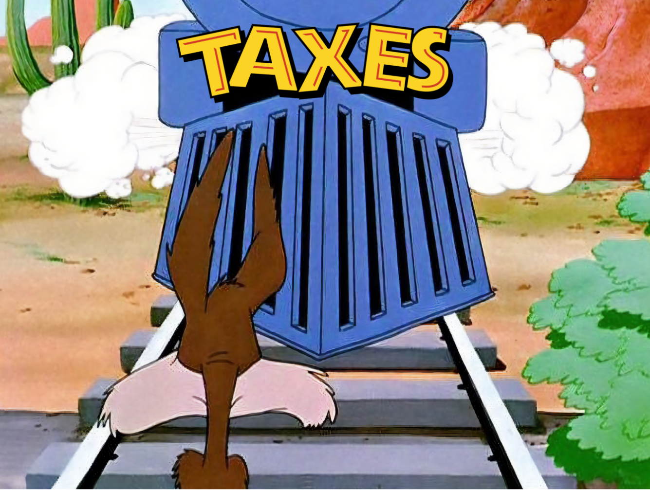
*Insert Logo Here

Slide 23



Ordinary Income
Type of Taxes
Wages
Pensions
Social Security*
Short term cap gains
Capital Gains
0%, 15%, 20%
Gains from investments held 366 days or longer.
Additional 3.8% surcharge – for high income earners
Estate / Death & Shadow Tax
40% + Potential local estate/ death rates
Shadow Taxes…
Penalties from Medicare / IRMA
Forced Income/SS tax
*Insert Logo Here
Notes:
Three types of taxes.
1. Ordinary = progressive. Explain the effect of additional dollar.
2. Cap gains: NII surtax (*3.8%) approx. 250k in cap gains triggers it. Complex calc. top cap gains is effectively 23.8% + state (5.6% ga)
3. Estate tax – probably could roll back with future admin.
Shadow taxes = IRMMA penalty

Slide 24
Types of Accounts
Tax Deferred
401(k)
403(b)
457(A)
IRA
Simple
Sep
CB Pension
Taxable
Brokerage Account
CD
Savings
Trust
Tax Free
Roth IRA
Certain Types of Insurance
HSA
*Insert Logo Here
Notes:
Big Picture: Tax-Deferred Wealth in America
- There are 37 types of tax-deferred accounts.
- 91% of the average American’s net worth sits in tax-deferred assets.
- That represents roughly $32 trillion.
- In practical terms: 91% of the average American’s liquid net worth is tax-deferred

Slide 25
Asset Location
Tax Loss Harvesting
The Essentials
Notes:
These are the basic must do’s…. Default should happen if you have an advisor.

Slide 26
Why Asset Location Matters
Optimizing which accounts hold which investments can improve after-tax outcomes—often without changing your overall risk.
0.41%
15%
$8.2k+
Annual Boost
Long-term Impact
Dollar Savings / Year
Potential increase in annual after-tax returns from optimal asset location
Illustrative increase in after-tax wealth over 20 years when savings are reinvested*
Potential annual reduction in tax drag on a $2M portfolio (highest bracket example)
Asset location can significantly impact after-tax returns. The strategy can create more wealth without taking additional investment risk.
*15% figure is illustrative (assumes reinvesting $8,200/yr at 6% for 20 years). Source for underlying estimates: Charles Schwab Center for Financial Research.
Notes:
Only free lunch I know of. No more risk but more net return.
[Sources] - https://www.schwab.com/learn/story/how-asset-location-can-help-save-on-taxes (0.14–0.41 percentage point annual after-tax return boost; $2,800–$8,200 annual reduction in tax drag example for $2M portfolio) [/Sources]

Slide 27
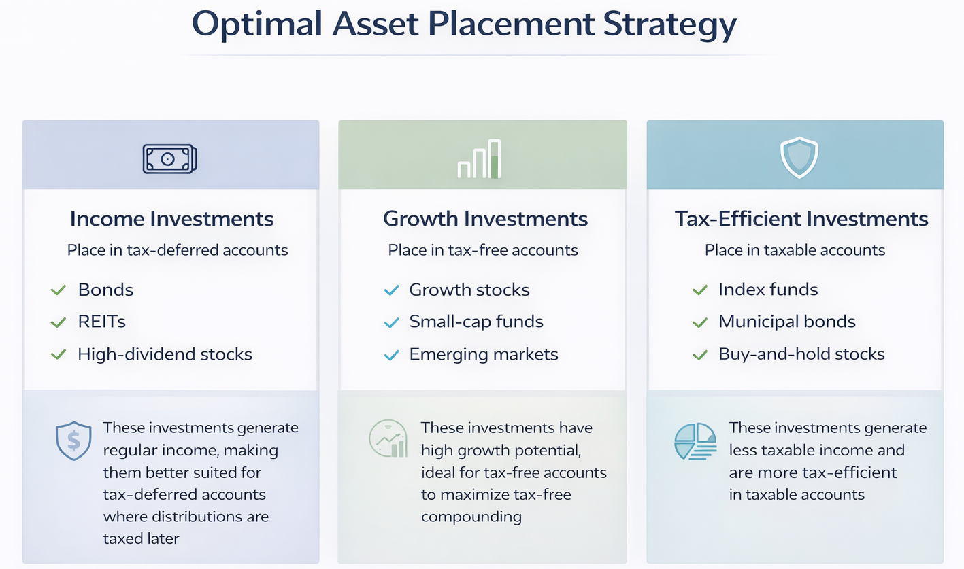
Notes:
- Use examples → IE if you bought NVIDIA five years ago where do you wish you held it? → Ira/Roth or taxable? → Roth clearly.
- Reiterate that we often see same allocation across all accounts = inefficiency.

Slide 28

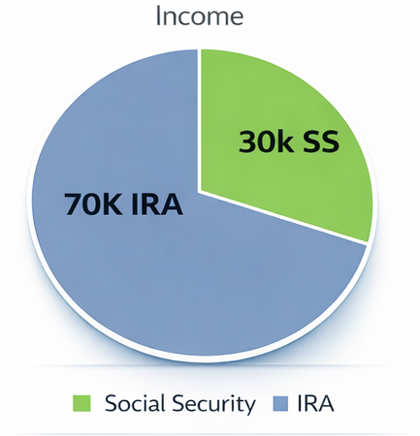
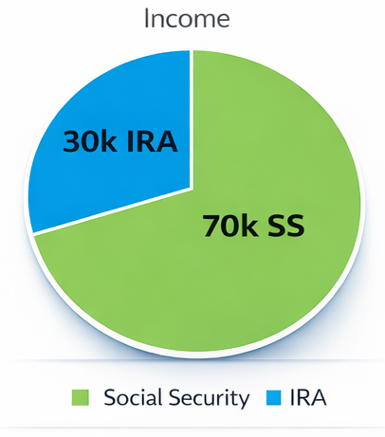
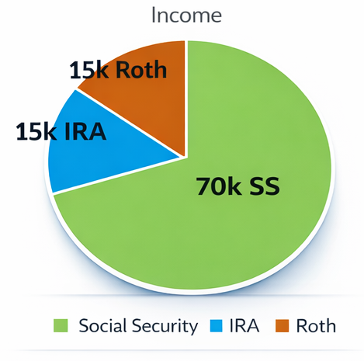



Notes:
Taxes based on “provisional income”. Other income/gains can make more of your ss taxable. Example: John has a CD (anybody know what this stands for?.. Well, yes but we call it a certificate of disappointment because it normally doesn’t keep up with inflation). He earns 100.00 in interest this year. He thinks he will pay 12% tax on this income or $12.00. However, that 100 pulls an additional 100 from his ss into his taxable income so now he owes 22 on that interest. Add in his 5.6% state income tax and he’s now at nearly 28% effective tax more than double what he expected.
Can’t get everyone into a tax-free retirement but it’s great to make the call to a client and let them know they are done with the federal tax bills and are good to go the rest of the way.

Slide 29
Bob & Mary
Social Security for Bob: $30,000
Pension → 100% Joint & Survivor: $45,000
Social Security for Mary: $15,000
STANDARD DEDUCTION & PERSONAL EXEMPTION
IRA → $1,000,000 RMD: $40,000
Filing Status | Deduction Amount
Single | $16,100
Married | $32,200
Head of Household | $24,150
Total Income: $130,000
Standard Deductions: $32,200
Additional Exemption: $7,650
TAXABLE INCOME: $83,400
Notes:
75. Retired 15 years.
- Bob SS is 30k
- *They offered pension DB plan → now when bob started the pension, he chose 100% survivor benefit to take care of Mary*
- A little over 2k month for 15 years now (private pensions don’t have colas)
- Pension is 45k year
- Mary SS is 15k (does Mary have ss even though she didn’t work outside the home? → Yes. She has spousal benefit that she can
collect while Bob collects his. He MUST collect for her to collect).
- More income than ever in working years before they retired. When they killed the pension plan, they started a defined contribution plan – you know it as a 401k
- Ira 1 million: RMD 40k
- Income 123k
- Show tax code – Bob and Mary get to take some deductions – they are going to use the standard deduction $32,200
- Taxable income 83k
- Tax $9,512
- Additional Exemption: BBB Deduction (6k) + Additional Deduction 65+ (1.65k)

Slide 30

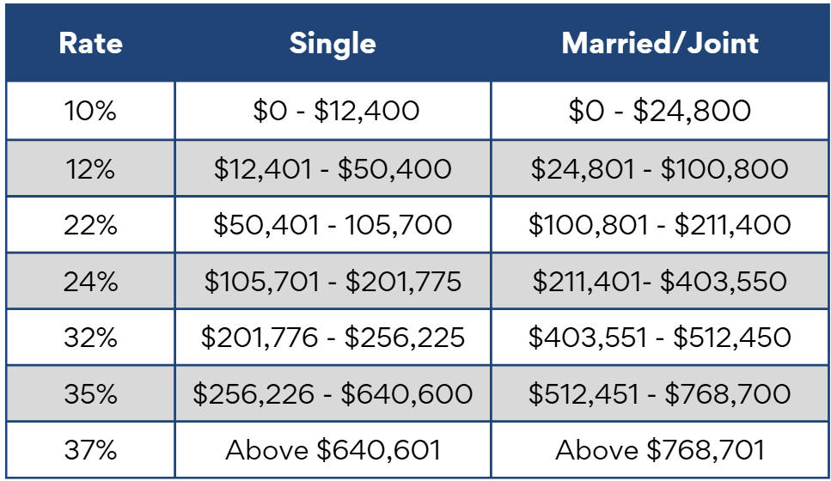
2026 Tax Rates

Slide 31
Bob & Mary
Social Security for Bob: $30,000
Pension → 100% Joint & Survivor: $45,000
Social Security for Mary: $15,000
Standard Deduction & Personal Exemption
IRA → $1,000,000 RMD: $40,000
Filing Status | Deduction Amount
Single | $16,100
Married | $32,200
Head of Household | $24,150
Total Income: $130,000
Standard Deductions: $32,200
Additional Exemption: $7,650
TAXABLE INCOME: $83,400
TAX BILL: $9,512
Notes:
*Some attendees may mention that the taxable income doesn’t add up*

Slide 32
Before Bob Passes
After Bob Passes
Now 75 Years Old – Retired for About 15 Years
Social Security for Bob: $30,000
Social Security for Bob: $30,000
Pension → 100% Joint & Survivor: $45,000
Pension → 100% Joint & Survivor: $45,000
Social Security for Mary: $15,000
Social Security Mary: $15,000
IRA → $1,000,000 RMD: $40,000
IRA → $1,000,000 RMD: $40,000
Total Income: $130,000
Total Income: $115,000
Standard Deductions: $32,200
Additional Exemption: $7,650
Standard Deductions: $16,100
Additional Exemption: $5,920
TAXABLE INCOME: $83,400 TAX BILL: $9,512
TAXABLE INCOME: $88,480
Notes:
Bob is no longer with us.
What income will Mary lose.. Well bob chose the survivor benefit, but she loses the small EROF SS
- SS is 30k
- Pension is 40k
- Ira is 40k
- Total is 110k
According to AARP surviving spouse need 27% less income so she should be “ok”…

Slide 33
83% Increase
Federal Income Tax Rates
*Insert Logo Here
Notes:
How's the tax code treating her now?
Taxable income is still 83 and change. But she files single → She just jumped 83% in her marginal tax rate – the single biggest jump in the tax code...

Slide 34
Before Bob Passes
After Bob Passes
Now 75 Years Old – Retired for About 15 Years
Social Security for Bob: $30,000
Social Security for Bob: $30,000
Pension → 100% Joint & Survivor: $45,000
Pension → 100% Joint & Survivor: $45,000
Social Security for Mary: $15,000
Social Security Mary: $15,000
IRA → $1,000,000 RMD: $40,000
IRA → $1,000,000 RMD: $40,000
Total Income: $130,000
Total Income: $115,000
Standard Deductions: $32,200
Additional Exemption: $7,650
Standard Deductions: $16,100
Additional Exemption: $5,920
TAXABLE INCOME: $83,400 TAX BILL: $9,512
TAXABLE INCOME: $88,480
49% Increase
TAX BILL: $14,178
Notes:
- Her tax bill increases nearly 50% even though she has LESS real income. Can I fix this? Not after Bob passes. But – the good news is that with appropriate strategy/planning, this situation is completely avoidable.
- One of the ways we would fix this is getting fund OUT of the IRA and into a Roth Ira. Would we want to do this all at one time – just lump sum it to a Roth? Absolutely not – that would be silly right? We would push them into a much higher effective tax bracket. We want to be strategic – we want to consider Medicare penalties, tax brackets, phase outs (new 6k exemption for seniors phases out from 150k-250k in income)…
Let's look at an illustration of how we would approach Roth conversions and what impact it would have on a scenario.

Slide 35
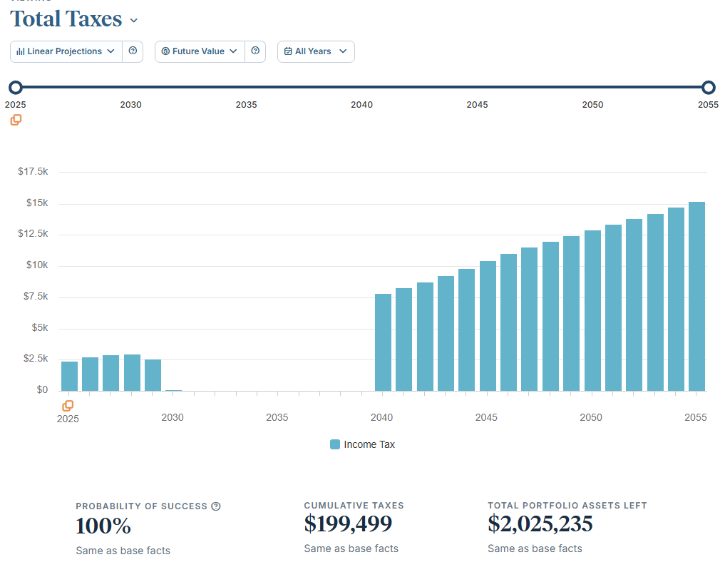
Notes:
- What are they looking at → Estimated total taxes over time.
- Why is it low from 2030 – 2040 → They are living off social security here and supplementing with after tax dollars (spending savings and not touching their “retirement money” until they must – which is a common theme).
- Discuss total lifetime tax 200k and end assets (nearly all in IRA passing fully taxable to heirs).
- Take advantage of the low rates. We are missing out on getting money out of Ira at 0/12/22%

Slide 36
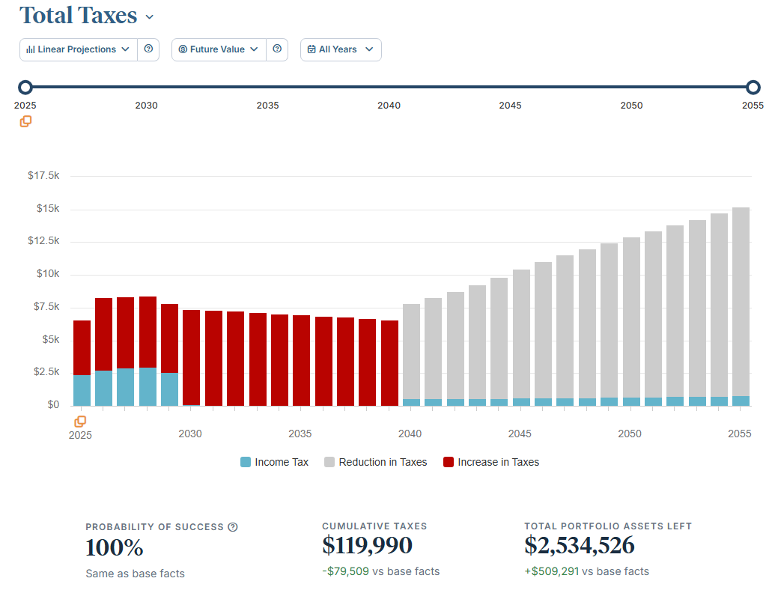
Notes:
1. Front load the conversions over time.. maxing out the 12% bracket.
2. Reduces lifetime tax by 40%
3. Increases net assets half a million…. PLUS, the 2.5 mil left over is now going to pass entirely TAX FREE to their heirs.

Slide 37

High Income Property Sale Tax Strategy
Charitable Remainder Trust (CRT)
Building purchase: $250,000
Now worth: $2,000,000
5% - Around $100K Yearly Income
Current Tax Law
$416,000
Biden’s first proposal $797,000
$35,000 Annual ILIT Premium
ILIT Second-to-Die $3.8 Million
*Insert Logo Here
Additional $386,000 Tax Savings on AGI Adjustment
Notes:
Bought for $250k grown and now grown to $2 million
- Using deferred sales trust for practice sales.
- Wanted rental income from building and pass it on to her two daughters.
- Other dr’s wanted control destiny and buy building.
- What’s it going cost to sell the building from tax perspective → Net investment tax 3.8% (one of 21 taxes embedded in Obamacare) and 20% cap gains – 23.8
- 737k marginal plus 3.8% sometimes suck it up and pay early.
- We want our clients to be in control and help you be a better steward of your own money – CRT
- How much tax is due… zero.
- Defer taxes but follow rules.
- Eliminated 400k in short term taxes. Invest in different manner because we don’t have to pay the tax man.
- Target 8-9% with a bit more tactical management style. Minimum 5% kick out income.
(By the way, this client was 56/ husband 57. theory should get a raise every year)
- Eliminated cap gains, given lifetime income but disinherited
- Doesn’t need income – funnel into other trust.

Slide 38





Qualified Charitable Distributions (QCD)
Direct IRA Donations
Transfer up to $105,000 annually directly from your IRA to qualified charities.
Age Requirement
Available once you reach age 70½, regardless of whether you're taking RMDs.
Tax Benefits
Amounts count toward your RMD but are excluded from taxable income.
Strategic Advantage
Can lower Medicare premiums and reduce Social Security taxation.
QCDs offer a rare opportunity to give to charity while completely avoiding income recognition—more advantageous than taking a distribution and then donating.
Notes:
- Many of our clients give charitably. If you write a check for charitable contributions… please stop. There are better ways to give.
- QCD: 70.5 or older, essentially full deduction on contribution because it never hits your income. Doesn’t increase Medicare (which is MAGI based). Satisfies RMD.
- Not 70.5 years old? Then let’s go with a DAF….

Slide 39
Donor-Advised Funds (DAFs)
What they are and how they work
What is it?
How it works (3 steps)
A charitable giving account maintained by a public 501(c)(3) “sponsoring organization.”
You make an irrevocable contribution; the sponsor has legal control of the assets.
You keep advisory privileges to recommend grants (and typically how assets are invested).
Contribute
1
Cash, securities, or other appreciated assets to your DAF account.
2
Invest (optional)
Recommend an allocation among the sponsor’s investment options while you plan your giving.
Why people use DAFs
Potential itemized tax deduction in the year you contribute (subject to limits).
Contribute now, then recommend grants over time—on your timetable.
Assets may be invested; growth is generally tax-free to the donor.
3
Recommend grants
Suggest grants to IRS-qualified charities. The sponsor reviews/processes the grants.
Considerations: fees may apply; grants must follow sponsor guidelines and go to eligible charities.
Notes:
Donation are fun when you don’t pay taxes
Lump sum contributions (future years now – ideally with appreciated stock)
File schedule A then standard.
Ls as many deductions as possible that year (2 years prop taxes, medical spending etc.)
Combine with Roth conversion.
[Sources] - IRS definition of donor-advised funds (sponsoring org, legal control, donor advisory privileges): https://www.irs.gov/charities-non-profits/charitable-organizations/donor-advised-funds - National Philanthropic Trust overview (donate now, grant later; assets may be invested; investment growth tax-free): https://www.nptrust.org/what-is-a-donor-advised-fund/ - DAFgiving360 (Schwab Charitable) FAQs (tax-smart framing; deduction eligibility; grant recipient eligibility; fees): https://www.dafgiving360.org/features/faqs [/Sources]

Slide 40
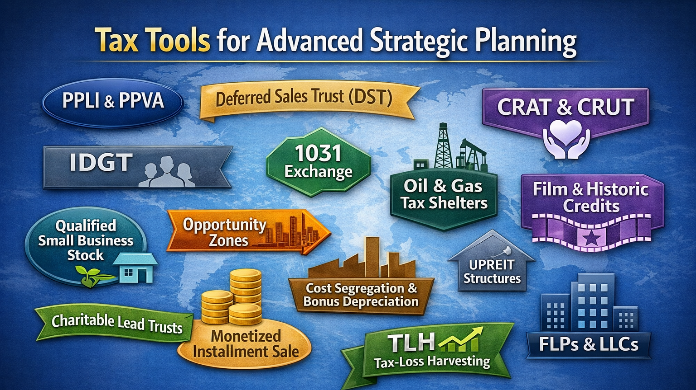
Notes:
“We just touched the surface of tax strategy. I hope this provides you with an idea of what is possible when you plan strategically, use the right tools and have the right advice.”
Go from here right into response form.

Slide 41
*Insert logo
*Insert picture of building
Get in touch with us
*Insert phone number
*Insert address
*Insert email
*Insert picture of team
Notes:
“If this is the kind of advice you are looking for – then we may be the firm for you. If you would like to take advantage of our office and talk with us 1 on 1, just click the link and pick a day and time that works for you. One of our team members will give you a call. We will start with a retirement report card and tax analysis to determine if there are opportunities to save you $$. This is completely complimentary and we would love to show you how this type of planning can benefit you and your family. I hope this was different than what you expected! We are short on time, so I won’t be able to get to all the questions, but I’ll grab a few here. Any questions we don’t get to here – I WILL get back to you this WEEK with an answer. “
“Have a great evening! I look forward to talking with you 1 on 1 soon.”

