Slide 1

Estate Planning
This material is provided courtesy of *Insert Firm Name* and contains general information to help you understand financial planning strategies.
*Insert Firm Name* is an independent financial services firm helping individuals create retirement strategies using a variety of investment and insurance products to custom suit their needs and objectives. Investing involves risk, including the potential loss of principal. No investment strategy can guarantee a profit or protect against loss in periods of declining values. Any comments regarding safety and guaranteed income streams refer only to fixed insurance products. They do not refer, in any way to securities or investment advisory products. Insurance and Annuity product guarantees are subject to the claims-paying ability of the issuing company. No legal advice, options or recommendations are being made in respect to this proposal. You should consult your tax professional or attorney concerning such advice and opinions.

Slide 2

The reaper will come for all of us. The question is what do we do between the time we are born and the time he shows up?
Because when he shows up, it’s too late to do all the things…
- RANDY PAUSCH
*Insert Firm Name
Notes:
Dr Randy Pausch- Computer Science at Carnegie Mellon-The Last Lecture

Slide 3
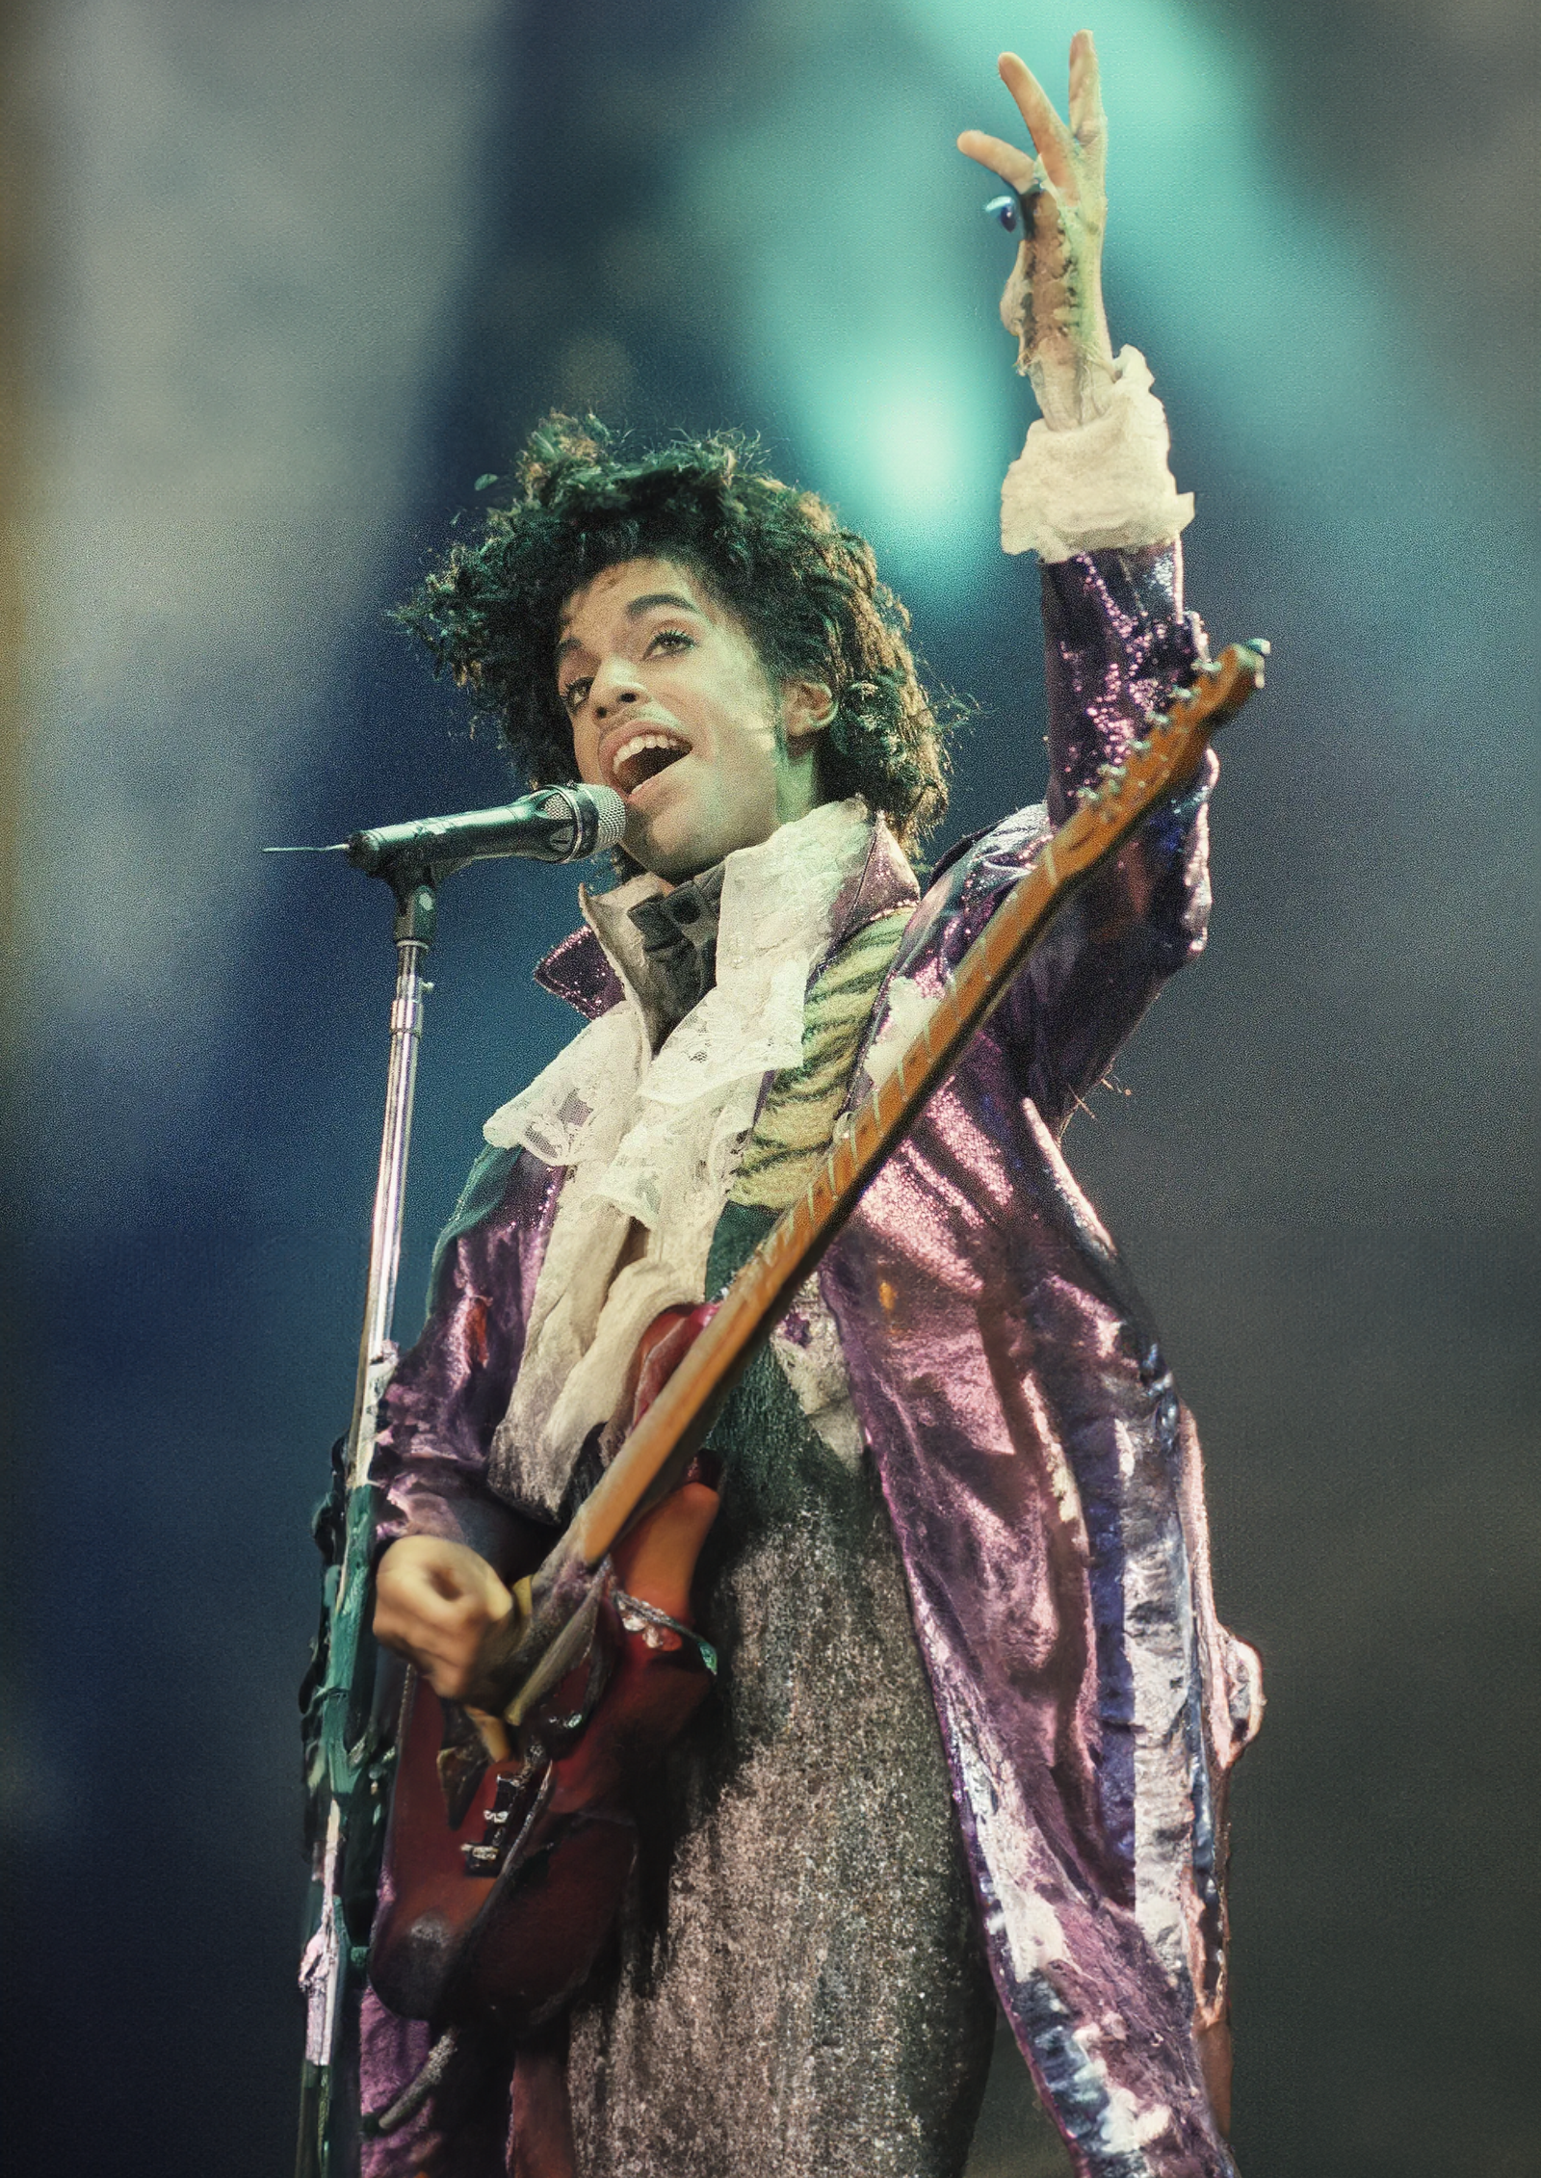
Who is this?
Notes:
Why famous estate planning community? He died intestate. Meaning with out a will or trust and benes
6 years-178 million-30 to fees, 40 taxes and the rest split up
Most of us wont have this….my mother example of the inheritance and siblings don’t speak

Slide 4
Intestacy
“The condition of the estate of a person who dies without having made a valid will or other binding declaration. Alternatively, this may also apply where a will has been made, but only applies to part of the estate. The remaining estate forms the “intestate estate.”
Notes:
Why famous estate planning community? He died intestate. Meaning with out a will or trust and benes
6 years-178 million-30 to fees, 40 taxes and the rest split up
Most of us wont have this….my mother I mean my wife's example of the inheritance and siblings don’t speak

Slide 5

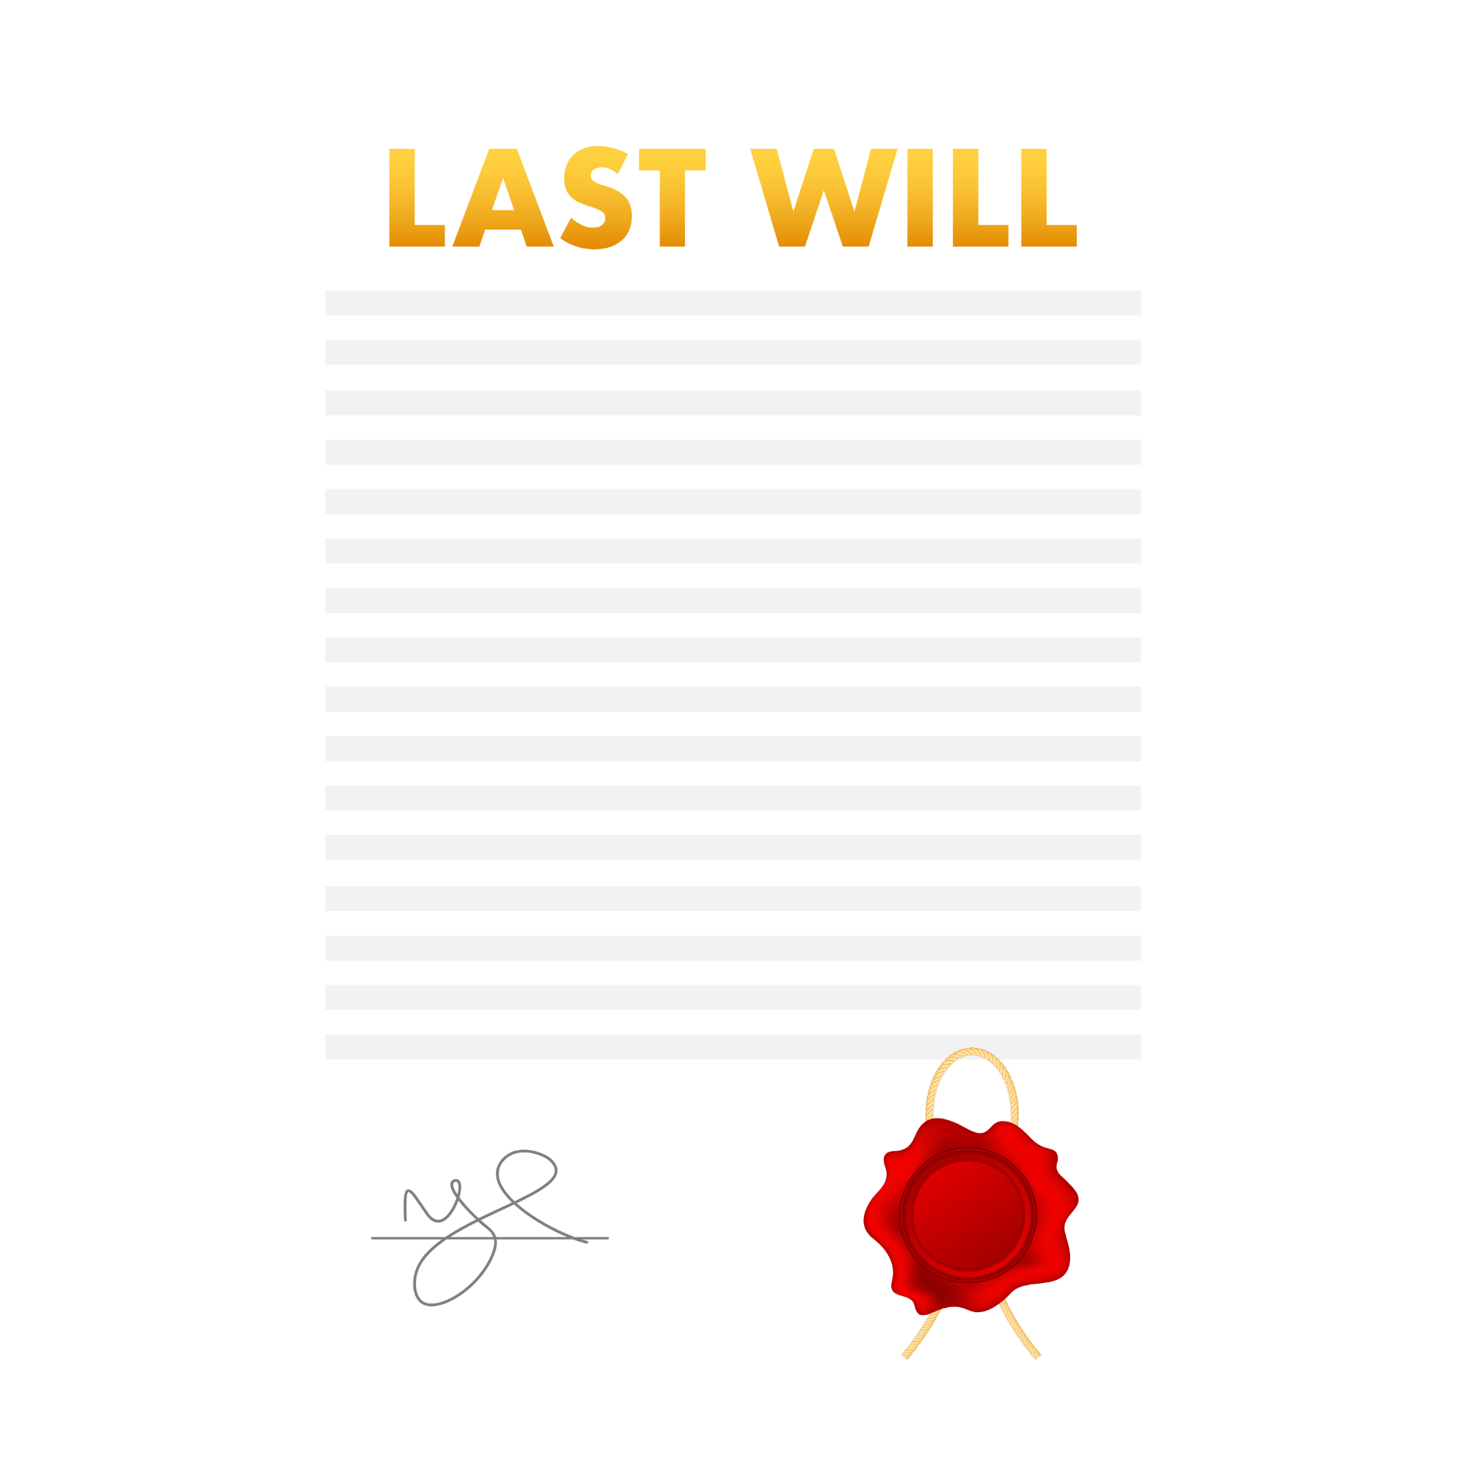


Death With No Will or Trust
Last Will
FAMILY MEMBERS MAY DISAGREE ABOUT YOUR WISHES
ESTATE DIVIDED ACCORDING TO STATE LAW
NO OFFICIAL DIRECTION
NO FINAL MESSAGE
Notes:
64% americans don’t know what an estate plan is, 68% adults don’t have a will, 84% under 35 no will, 79% adults no trust.
80% families belive passing wealkth is important and 60% of those don’t have a plan in place
5 misconceptions- later, complicated, I don’t own anything, depressing, burden loved ones

Slide 6

Agenda
Introduction
What is Estate Planning? – Legal vs Life
Estate Planning 101 - Legal
Estate Planning 201 - Life

Slide 7
Presenter, *Insert Name CFP®
Principal & Senior Wealth Advisor at *Firm Name
Alma Mater:
Spouse:
Hobbies:
*Insert Photo of Yourself
Notes:
Superpowers
Elephant in the room

Slide 8
Who is *Firm Name
Fiduciary advisors.
A comprehensive suite of services.
A team-based approach.
Tailored solutions.
Education and collaboration is our passion!
Notes:
Team of highly credential financial professionals that work in a collaborative effort with clients.
First Gen wealth creators- primarily biz owners, corporate employees and med professionals helping them transition tto
Elephant in the room

Slide 9
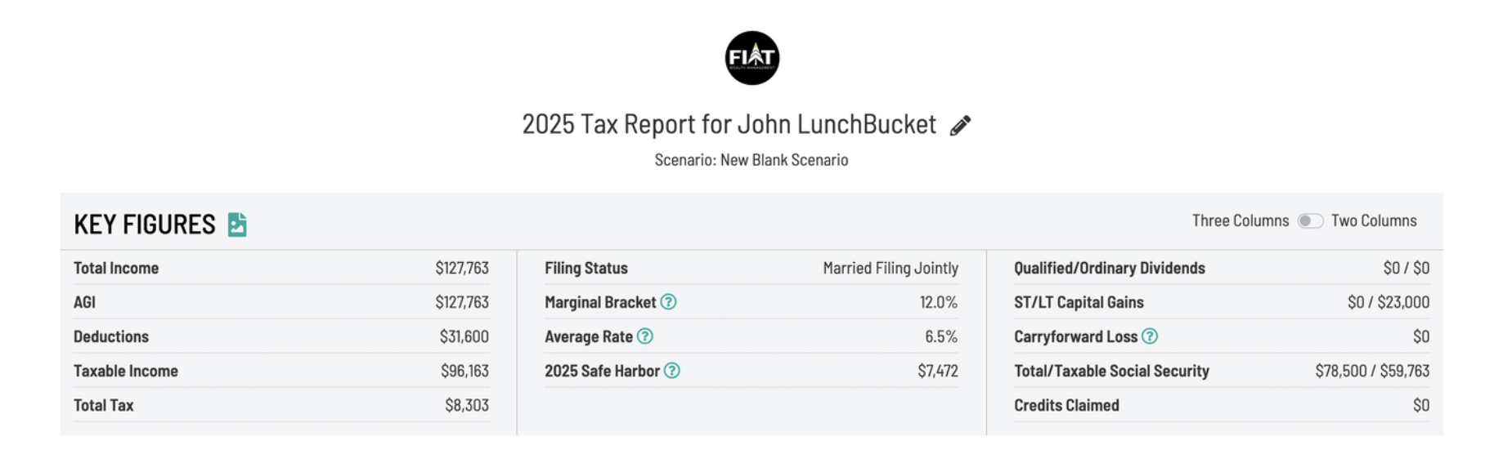
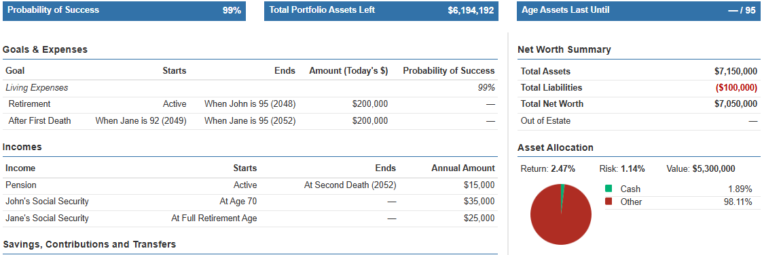
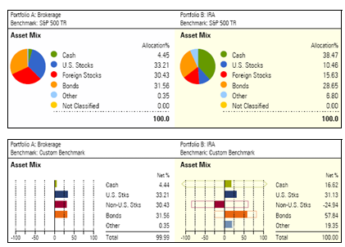
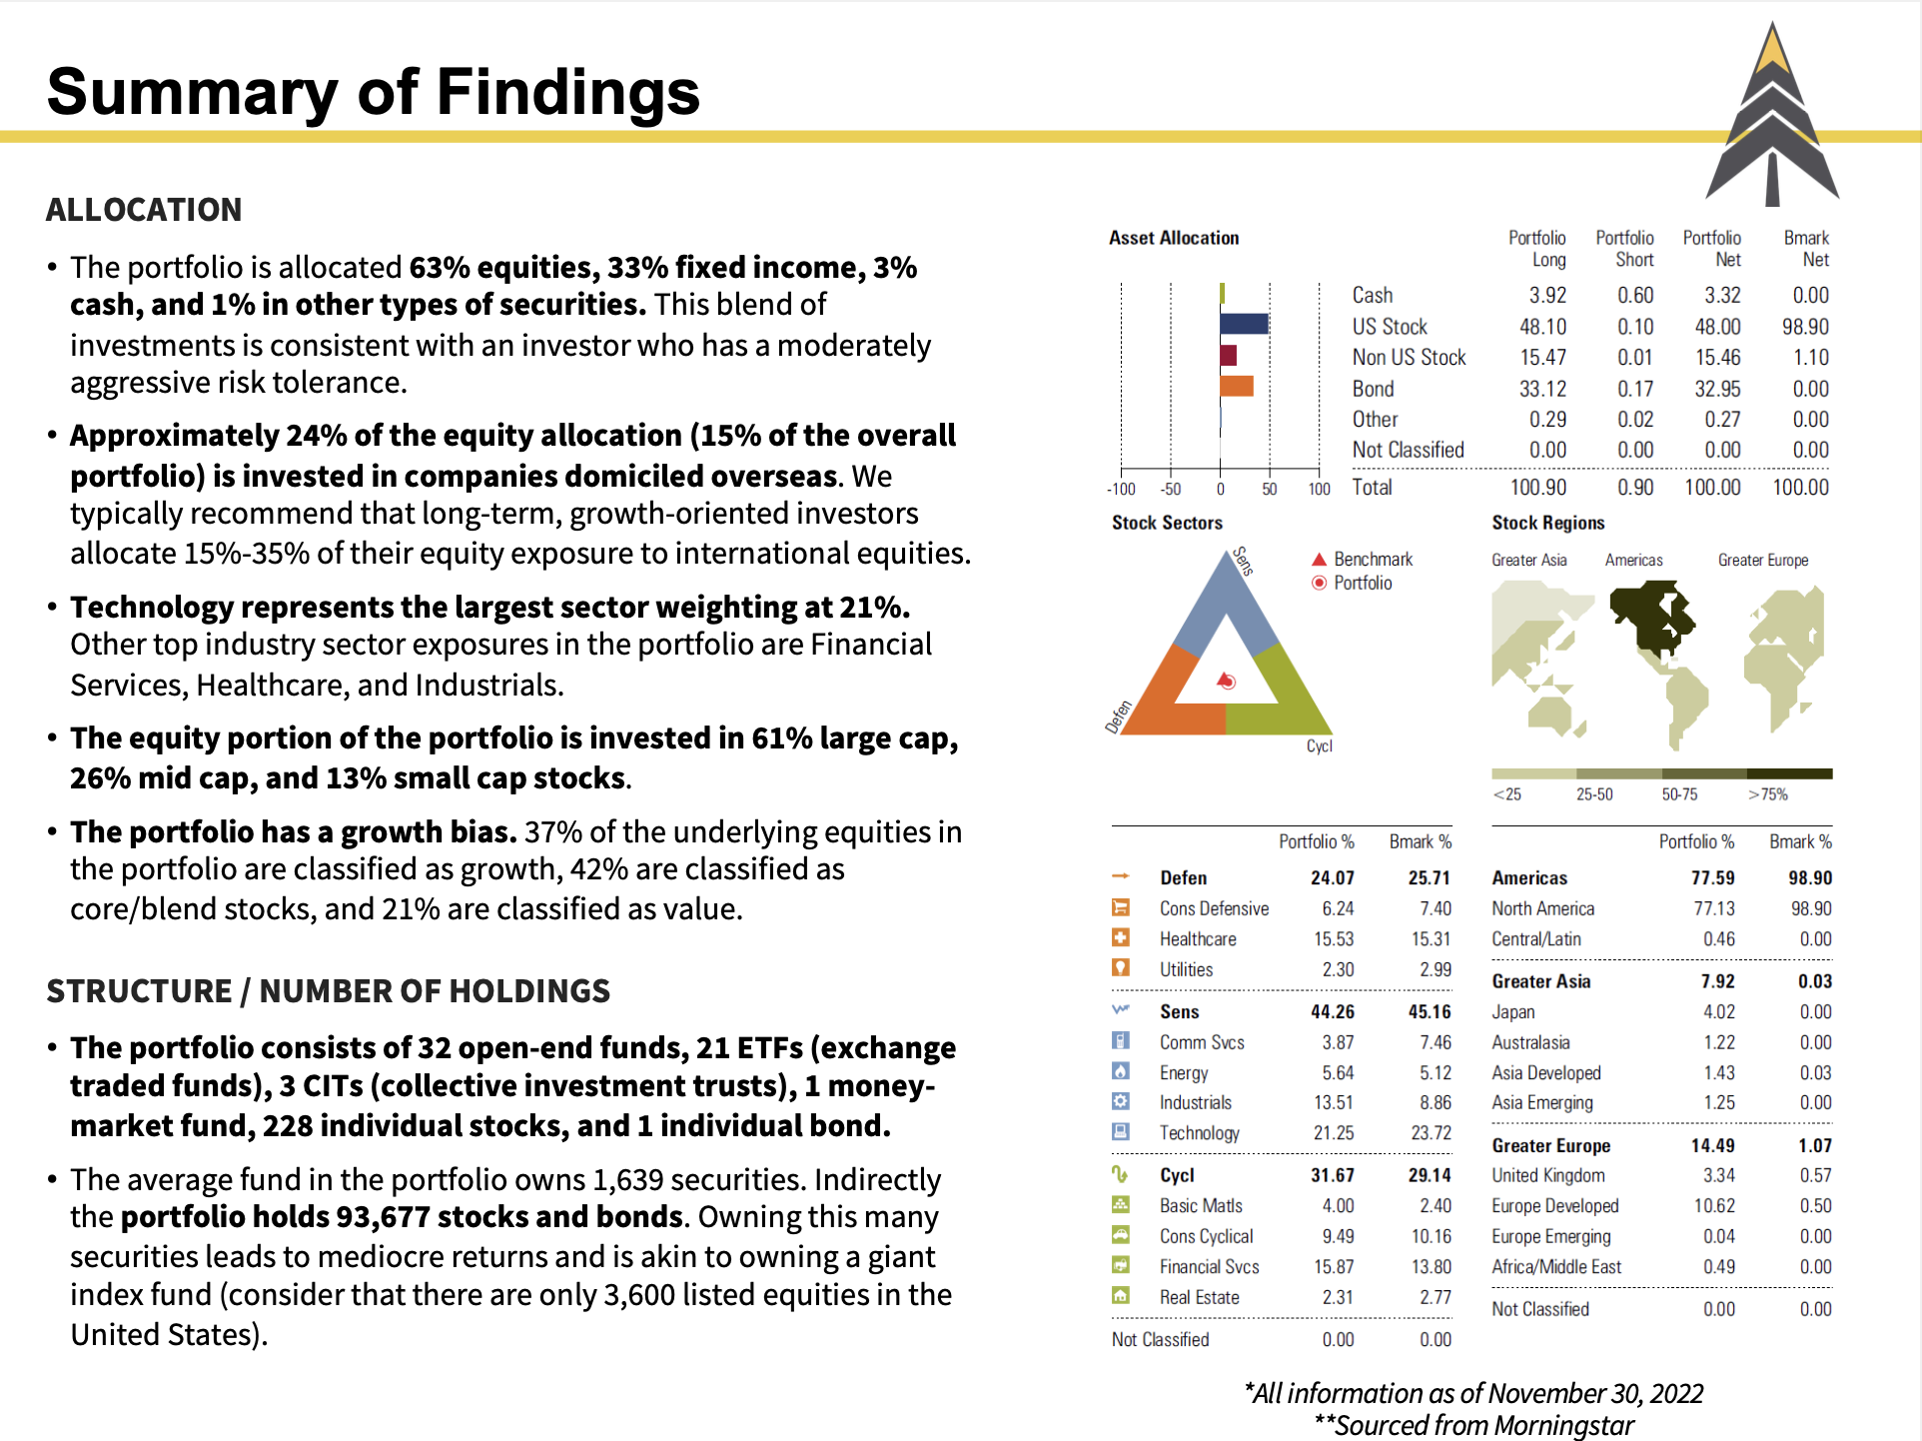
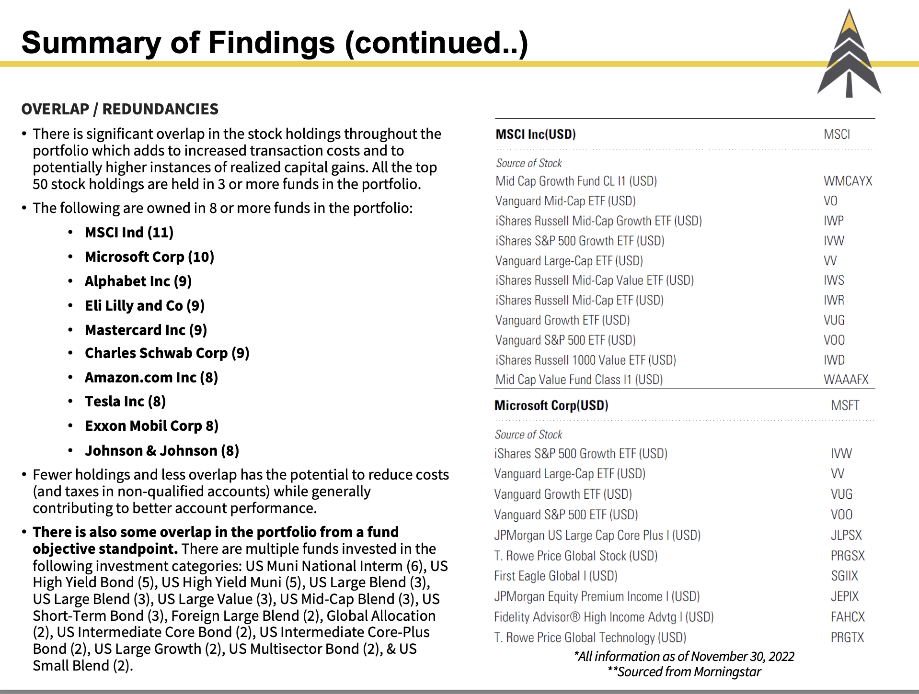
Complimentary Meeting:
What you offer in this
meeting
Notes:
What to expect,
What is covered

Slide 10
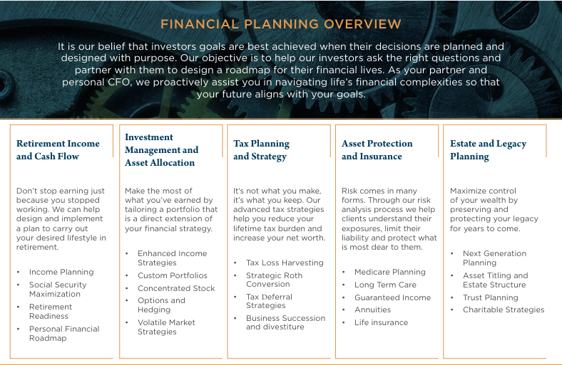
d
Notes:
I should start this with about 5-6 minutes into it.
In your Folder! If you don’t have it raise your hand. Website nothing for sale
Before we dive into our topic today a wanted to take a moment to highlight the 5 main pillars to wealth management: Our business is treating your assets and plan like a business. In order to accomplish that we dive deep into the 5 main pillars of WM
Cash Flow and Retirement Planning- Do I have enough money? Where will my next pay check come from? How do I fund my lifestyle?
Investments- Your portfolio of investments becomes the vehicle to help you get to your destination. Do I have the right asset allocation? Am I taking on too much risk or should I consider taking on more? Do I have sufficient assets for an emergency fund? How can I protect and grow my money?
Taxes- As a retiree taxes will likely be your biggest expense in retirement with the average retiree spending___________. Review and identify times to carry out roth conversion, how will this effect my federal rates? What about my Medicare Premiums?
“Tax planning is like going to the gym, there are things we do now that don’t necessarily feel good but over the long run we are better off as a result of it.

Slide 11

Who is here?
Notes:
Retired? Working?
Why are you here?

Slide 12
The presenter is in no way employed by, affiliated with, or endorsed by the IRS, the Social Security Administration or any other government agency. This presentation is not intended and should not be construed as tax advice. Please consult with an Enrolled Agent, CPA, or attorney before implementing any of the strategies discussed herein.
All examples are hypothetical and for illustrative purposes only. Actual results will vary. No part of this presentation is intended to make an offer of sale or purchase of any specific security or insurance product.
Notes:
Here are the mandatory disclosures. Keep in mind, I am a Financial Advisor, not a CPA, Enrolled Agent or Attorney, so the contents of this presentation are based on things I see day to day in my practice and are not specific advice for your situation.
Not attorney, general contractor. I have to tell you I don’t work for the federal government

Slide 13
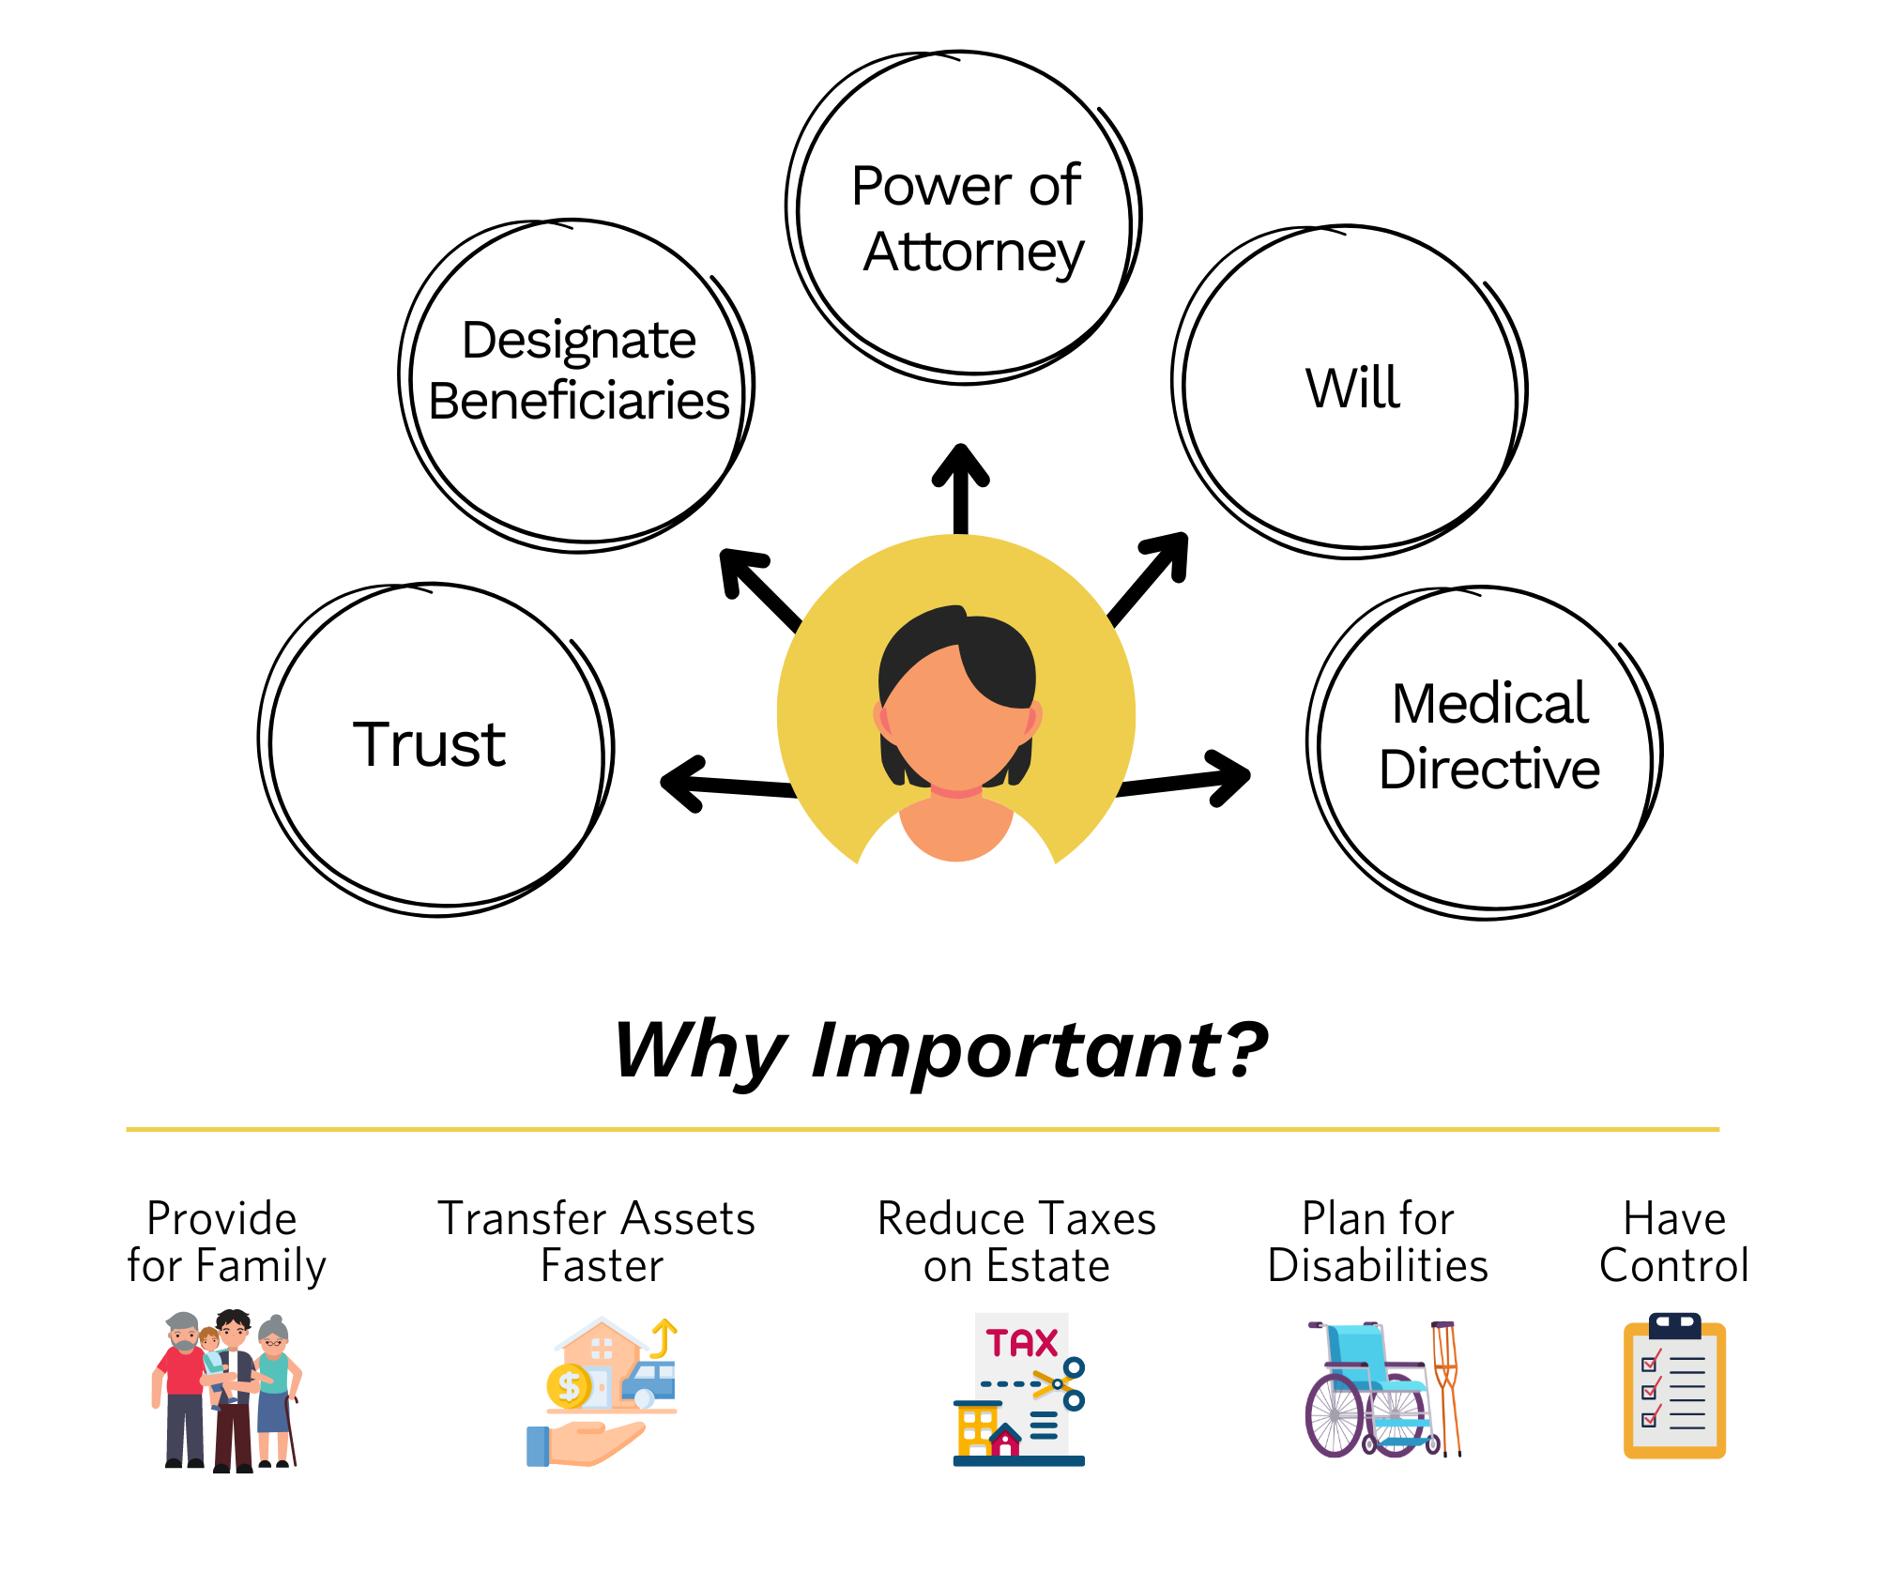
What is Estate Planning?
“
Nothing is certain except death and taxes.”
- BENJAMIN FRANKLIN
Notes:
The process of organizing your financial affairs and assets to ensure they are managed and distributed according to your wishes after your death or in case of incapacitation.
\"Will of Ulah," was found in a tomb in Egypt and dates back to 2548 BC. In this ancient will, Uah left all his property to his wife, Teta
Who here has established an estate plan?

Slide 14


Life
Legal
Notes:
Legal is the documents themselves-life is what in the world do I leave behind. What I leave
What is more important or where do I start.
People who have one wrapped up and not the other. Vice versa

Slide 15
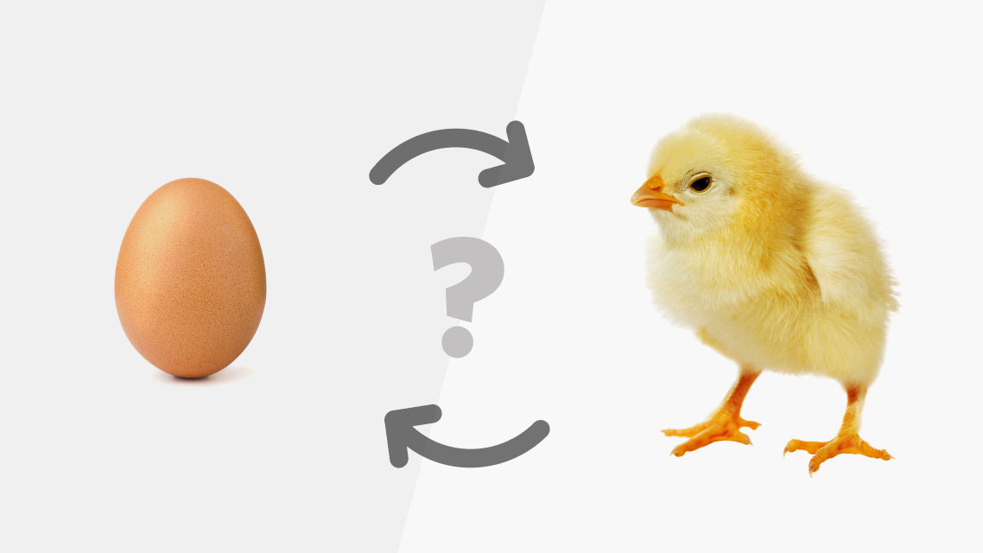
Notes:
Price of egg joke-
Have to have Both done- wonderful legal and life not wrapped up
Examples of great legal and no Life

Slide 16
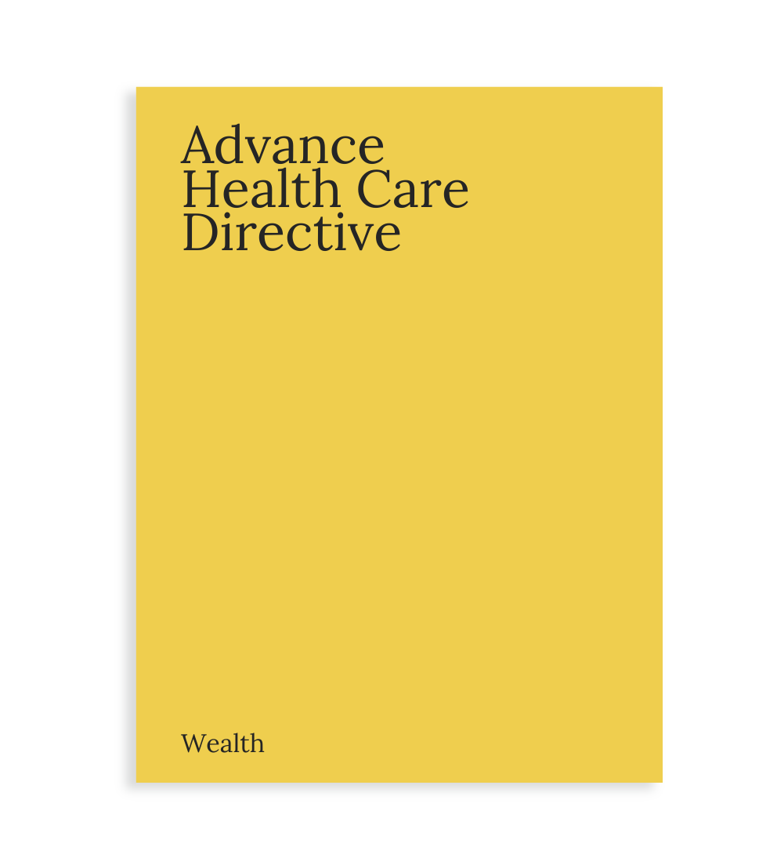

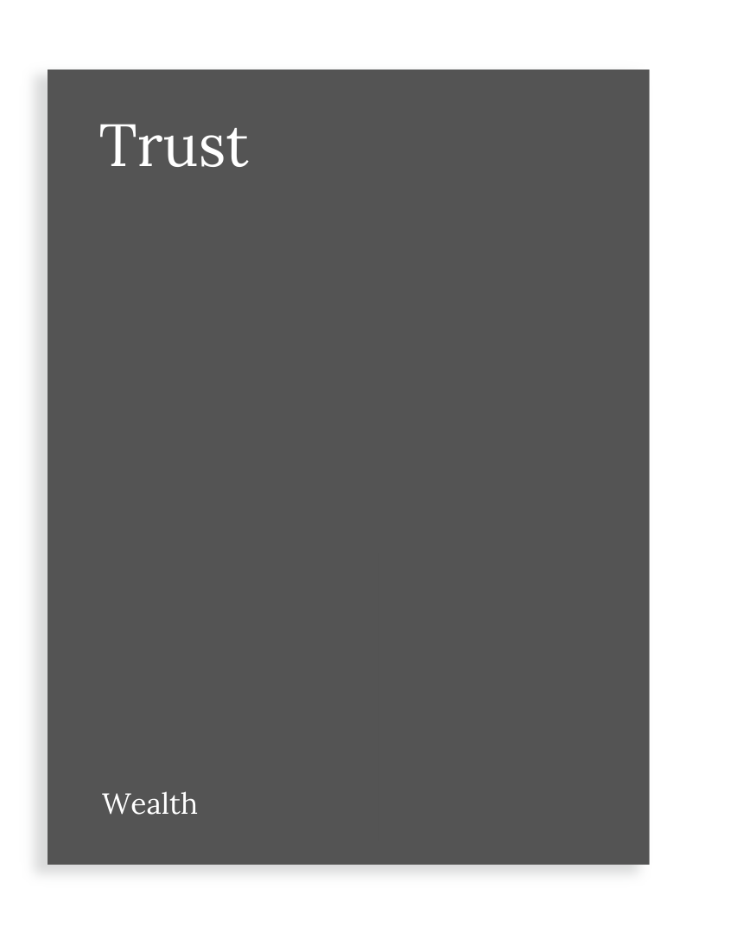
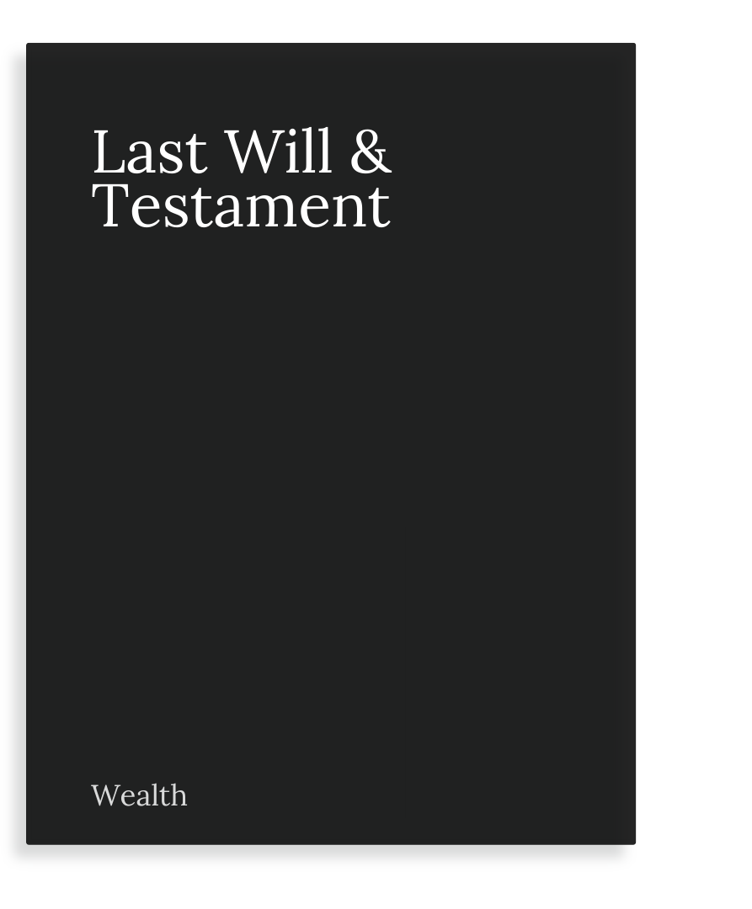
Estate Planning 101: Legal
How you leave it?

Slide 17

Advance Health Care Directive
Outlines medical treatment preferences
Used when you are unable to make medical decisions for yourself
Contents:
Care Proxy
Treatment Preferences
End-of-Life Care
Organ Donation
Notes:
Your voice when you need one- Private room at the hospital, organ doner, plug or un plug., cremation or burial
Healthcare directive your voice when you don’t have one when you don’t have a voice- give some examples: am I willing to pay for a private room in the hospital
Terri Schiavo College kids Old yeller

Slide 18
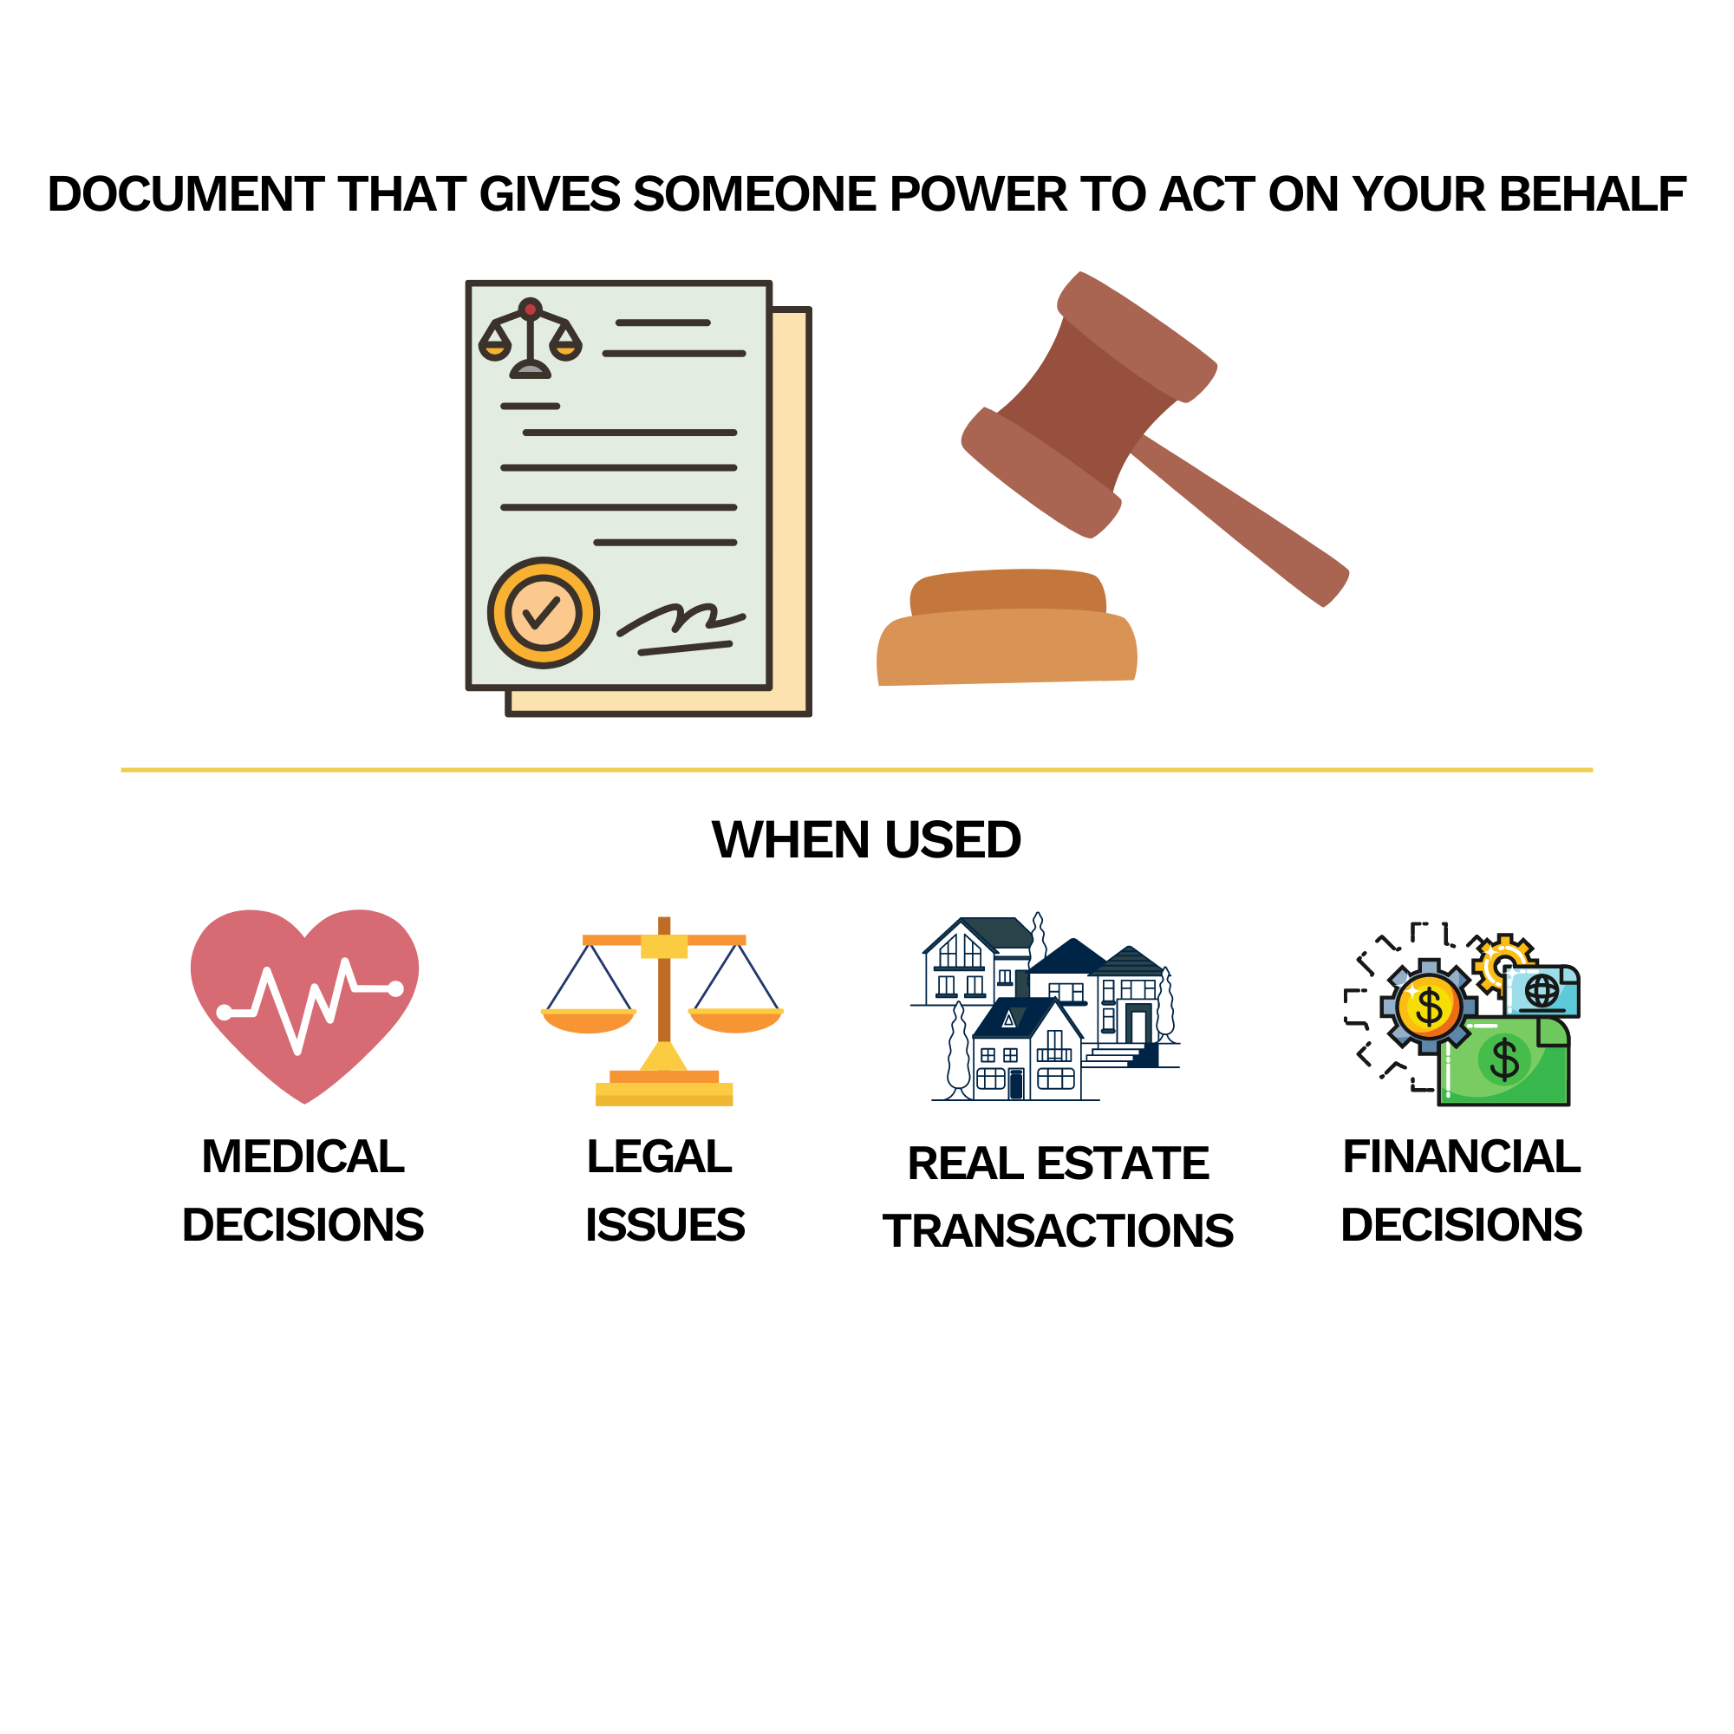
Financial Power of Attorney
- Grants authority to act on behalf of another
General Power of Attorney
Used when the principal is unable to manager their affairs
Limited Power of Attorney
Grants specific powers for a limited period or purpose
Notes:
What is a POA- Durable v Non Durable, Someone you trust
Brokerage firm v poa
Example of the 5 kids- that client referred
Mama Pupi story-
Spouse POA?

Slide 19
Estate Planning 101: Legal
How you leave it?

Slide 20
Movement of Assets
NON-PROBATE ASSETS
PROBATE ASSETS
If the asset is in your name alone, without a beneficiary, it is distributed as part of the probate court process.
Is the asset owned by a TRUST or does it name the trust as a beneficiary?
Does the asset have a JOINT OWNER?
Does the asset have designated beneficiaries?
No
No
No
*Yes
Yes
Last Will and Testament
No will
Yes
Joint owner inherits
Designated beneficiaries inherit
Trust beneficiaries inherit
Will beneficiaries inherit
Your next-of-kin inherit
*Joint Tenants in Common is an exception
Notes:
Reach in your folders!
Types of JT- TIC, TBE, WROS- Not community property partial step up
Benes_Per stirpes and not per stirpes
Example of a clients friend (old spouse) did not update the beneficiaries. (when I first started working)
Does a will avoid probate?
July 2024 you can add benes to property
Cost of probate in GA 10-15%

Slide 21
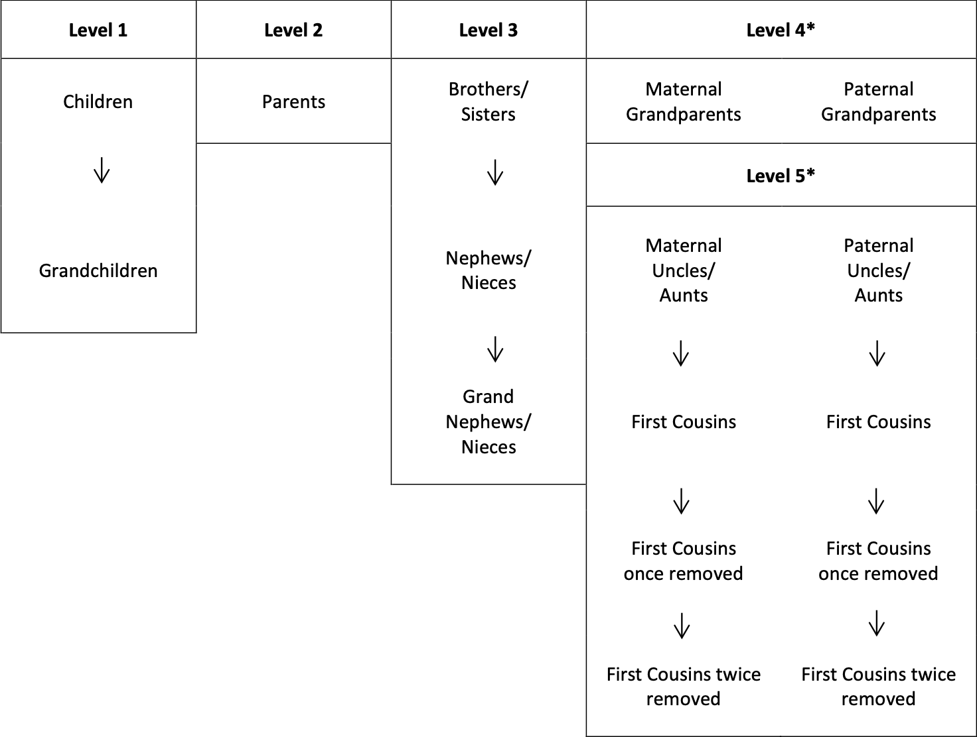
Death with
no Will or Trust
“Intestate”
Notes:
No non blood relatives on that list! Friends- inlaws charities- restrictions with disabilities.

Slide 22
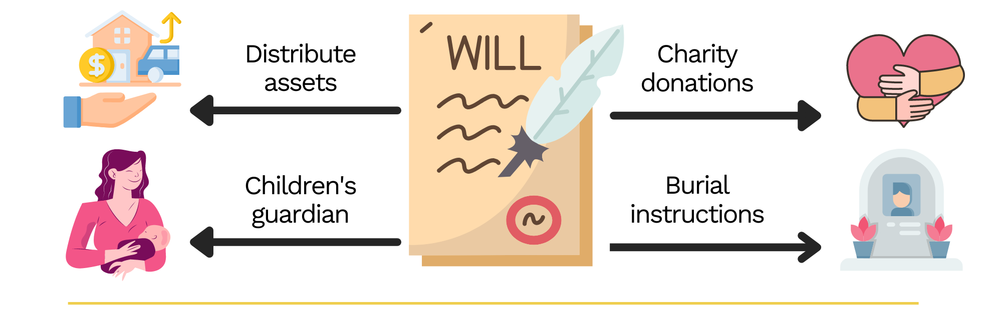
Last Will & Testament
DISTRIBUTION OF ASSETS AND AFFAIRS AFTER DEATH
Pros:
Distribution of assets
Executor appointment
Guardianship for minors
Customization
Cons:
Formality and legal requirements
Probate process
Public record
Limitations on non-probate assets
Changes in circumstances
Notes:
This is where families fall apart (conversation with mom) (moving of the mango trees)
Your name as executor-it’s a lot of work. Don’t shoot the messenger.
Get your family together- talk to the ones you named and the ones you didn’t nameExample of a client where one kid does well and the other does not and leave more to other
Story of man who left ex wife

Slide 23
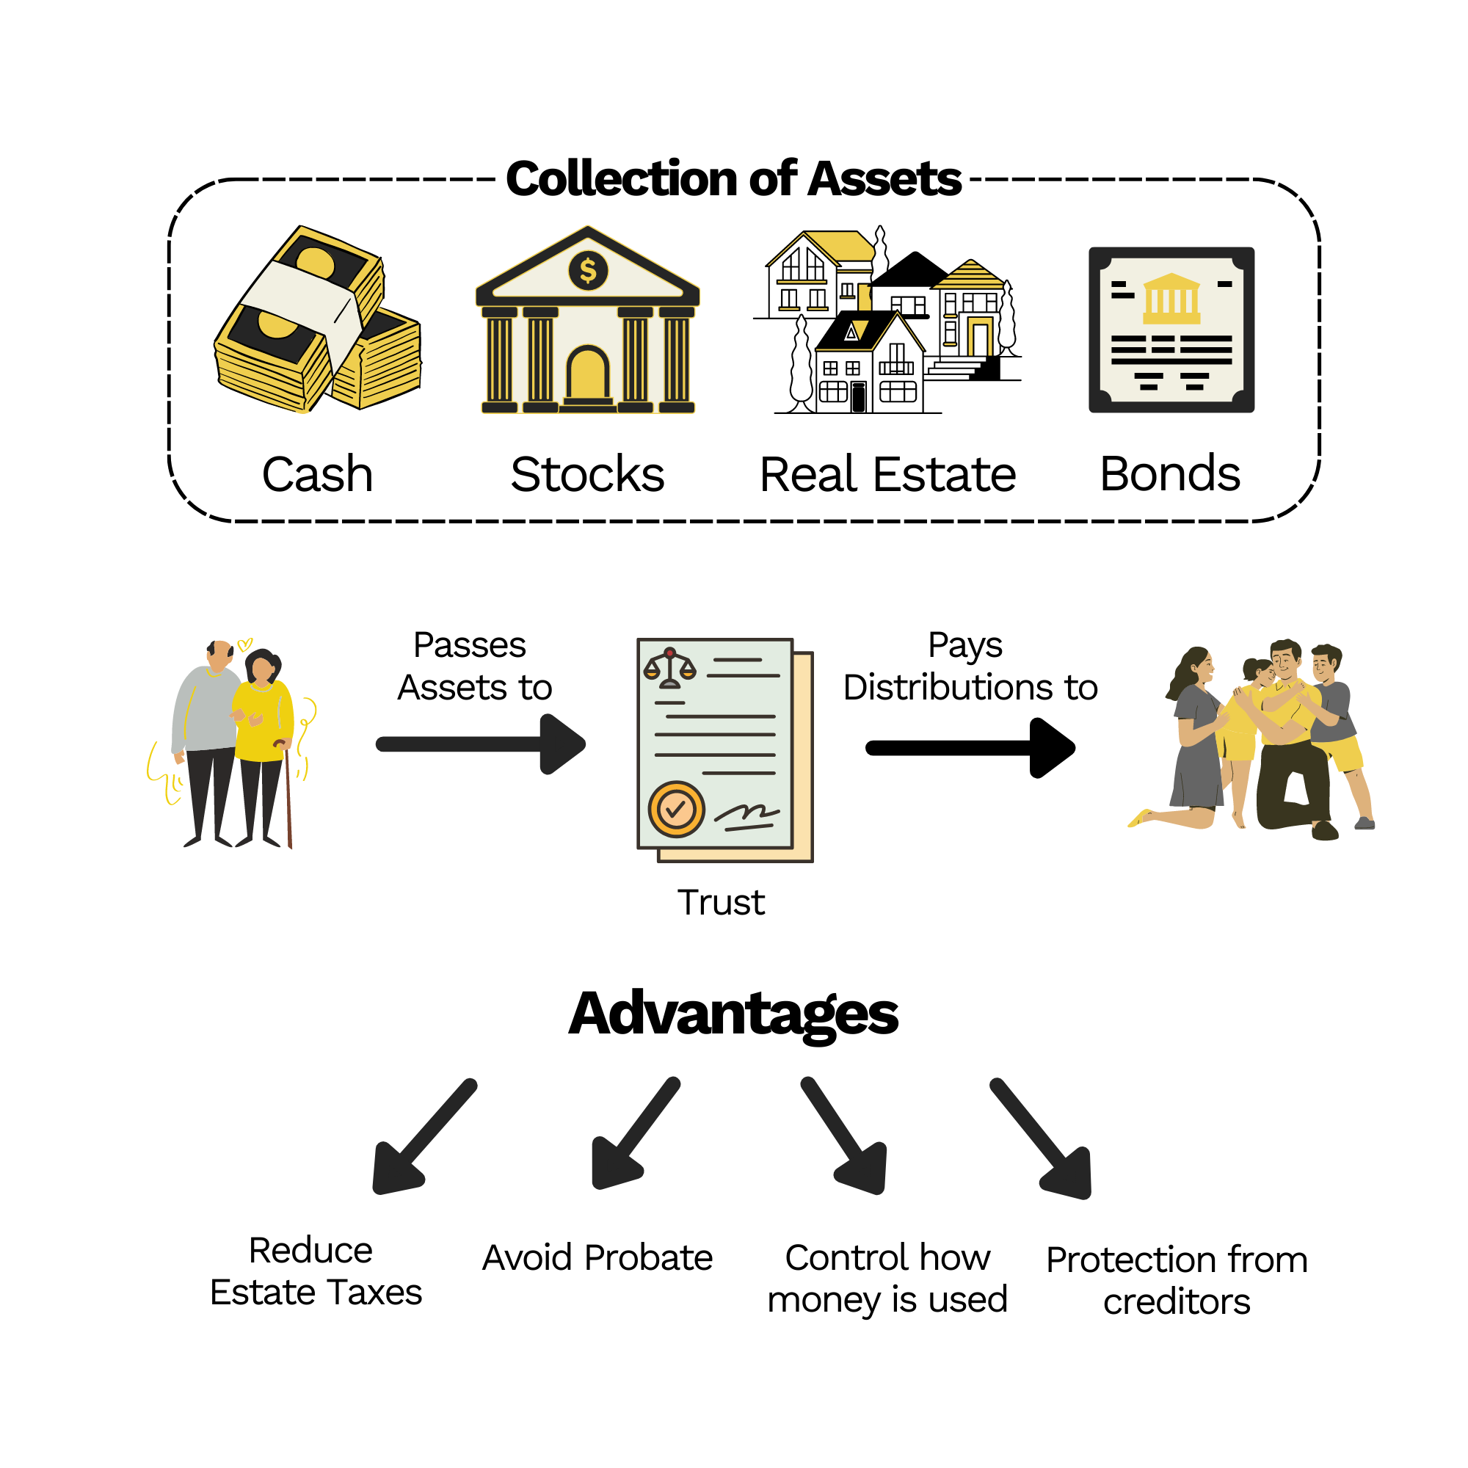


Trust
^{PROVIDES INSTRUCTION OF THE} ^{ASSETS OF THE TRUST}
Revocable - Flexibility
Can be changed or dissolved
Assets can be moved in or out
Irrevocable - Give up control
Assets out of Grantor’s Estate
Assets can not be moved out
Notes:
Avoid probate- Cost of probate 3-7% 12-18 months
Components of a trust
Anybody hear have a safe?
Who here shows their checkbook to people?

Slide 24
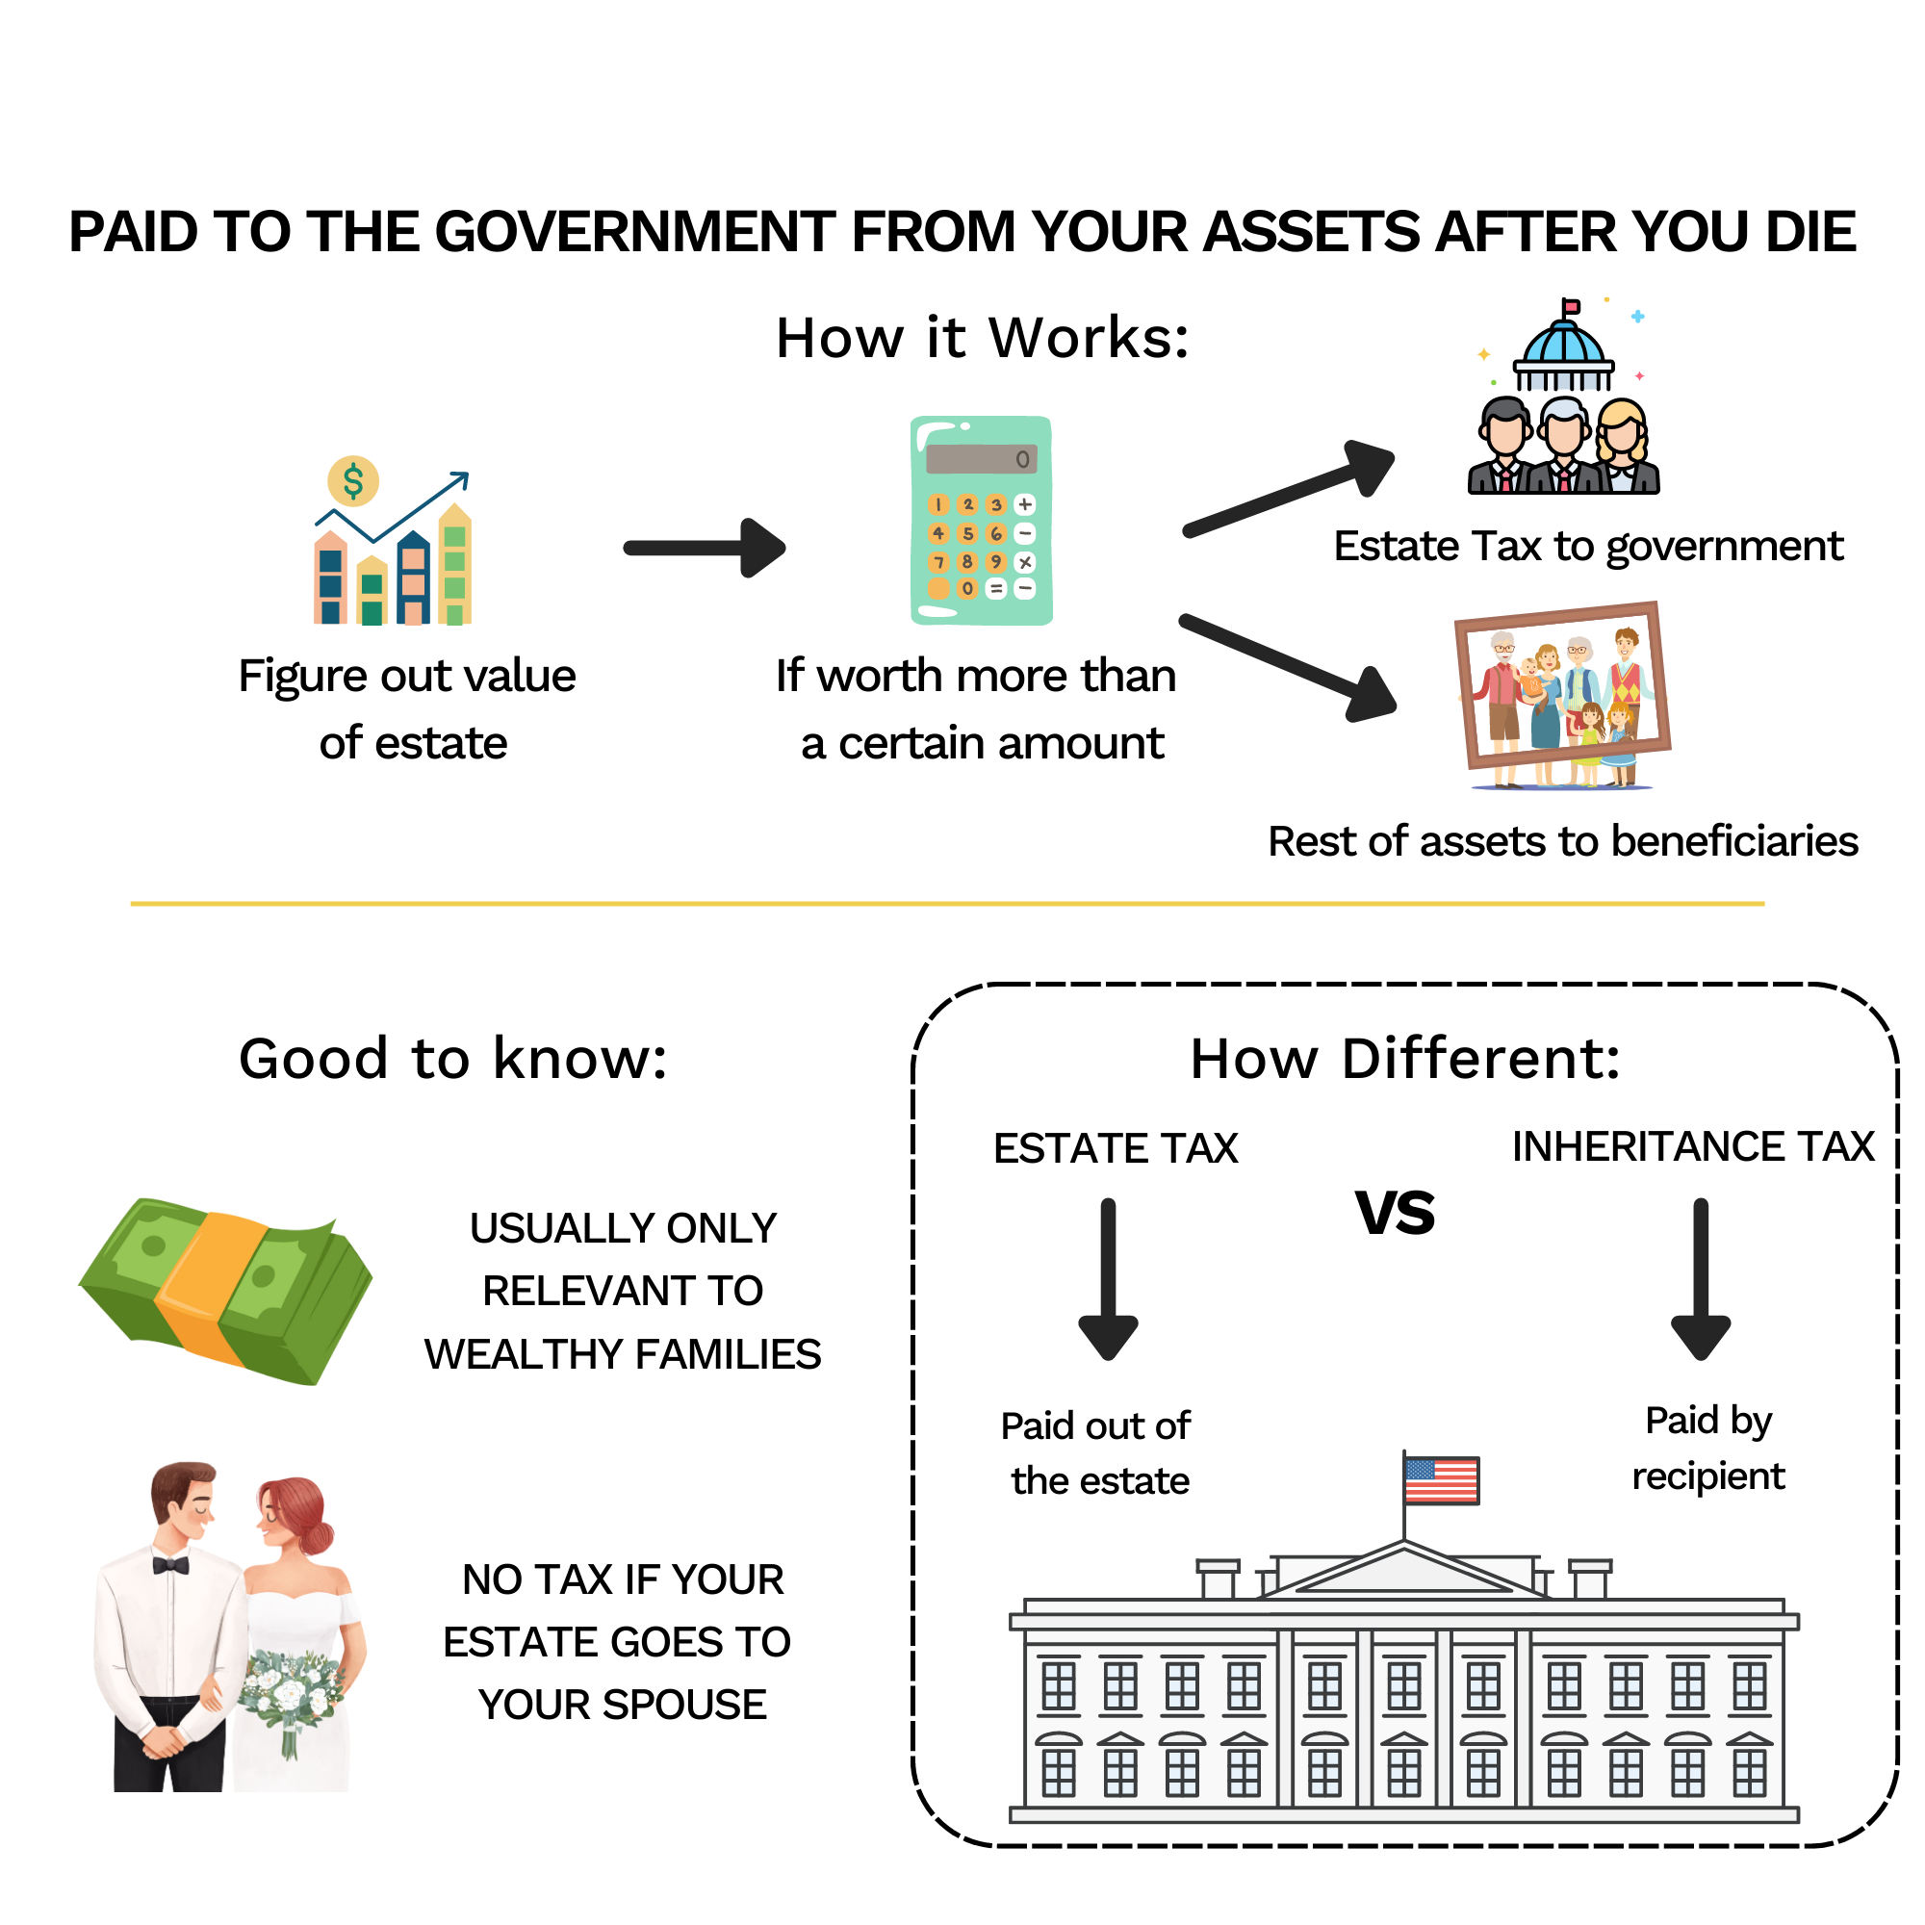
Estate Tax
^{TAX ON YOUR RIGHT TO}
^{TRANSFER PROPERTY AT DEATH}
Exemptions (2025)
Federal: $13.99M
Gifting Limit (2025)
Federal: $19,000
Single rates
*Exemptions sunset in 2026
Notes:
709 gift tax return
Trust tax rates at different levels
1,000,090 =19k + 990k

Slide 25
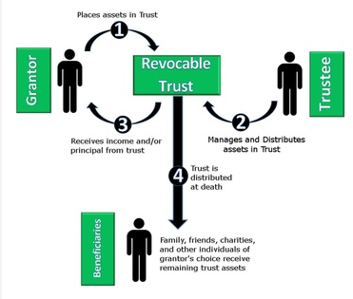
Revocable Trust
^{Control}
^{Avoids Probate}
^{Transfers Efficiently}
Notes:
Structure it

Slide 26
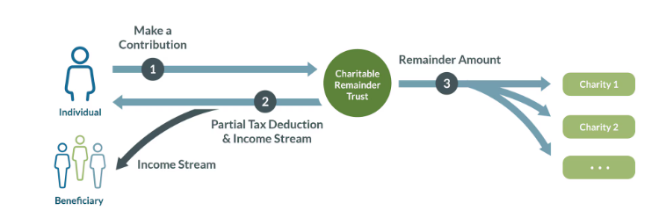
Charitable Remainder Trust
^{Income}
^{Tax Benefits}
^{Irrevocable}
Single rates
*Exemptions sunset in 2026
Notes:
CRT- Condo100k Sold for 1.1 Gain 1 mil tax @ 30% Netted 700k

Slide 27
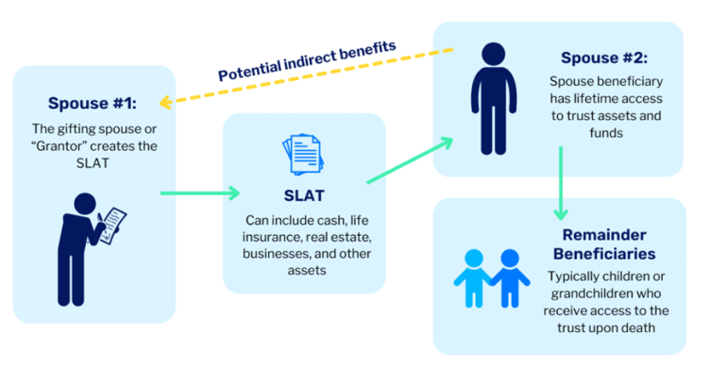
Spousal Lifetime Access Trust
^{Income}
^{Tax Benefits}
^{Irrevocable}
Single rates
*Exemptions sunset in 2026
Notes:
Marcel egg incubation (munsters)
14 million not trust- the business sold that 14 mil was 30 mil saved 12 million

Slide 28

Checklist
1. Do you have the following (check if yes)
Have your documents been updated in
the last 3 years?
Will
Trust
If you have a Trust, is it funded?
Health Care Directive
Power of Attorney
Do you know how your Estate plan works ?
If so, last updated ______________
Have I changed states since I last updated.
Are your beneficiaries up to date?

Slide 29
Estate Planning 201: Life What you leave
3 Types of Money
To convert or not to convert
Widows Tax
“
Nothing is certain except death and taxes.”
- BENJAMIN FRANKLIN

Slide 30
Three Types of Money
PRE-TAX
AFTER-TAX
TAX-FREE
401(K)/IRA
NQ INV
ROTH IRA
ABC STOCK

Slide 31
Three Types of Money
PRE-TAX
AFTER-TAX
TAX-FREE
401(K)/IRA
NQ INV
ROTH IRA
ORDINARY INCOME
10/12/22/24/32/35/37
*7 BUCKETS
L.T. CAP GAINS
0/15/20
*3 BUCKETS
TAX-FREE
ABC STOCK

Slide 32
Three Types of Money
PRE-TAX
AFTER-TAX
TAX-FREE
401(K)/IRA
NQ INV
ROTH IRA
ORDINARY INCOME
10/12/22/24/32/35/37
*7 BUCKETS
L.T. CAP GAINS
0/15/20
*3 BUCKETS
TAX-FREE
ABC STOCK
LOSE
LOSE
LOSE
TAX LOSS HARVESTING!

Slide 33
Three Types of Money
PRE-TAX
AFTER-TAX
TAX-FREE
401(K)/IRA
NQ INV
ROTH IRA
ORDINARY INCOME
10/12/22/24/32/35/37
*7 BUCKETS
L.T. CAP GAINS
0/15/20
*3 BUCKETS
TAX-FREE
ABC STOCK
LOSE
LOSE
LOSE
TAX LOSS HARVESTING!
At Death
FULLY TAXABLE
STEP-UP BASIS**
TAX FREE

Slide 34
Three Types of Money
LESS
RISK
MORE
PRE-TAX
AFTER-TAX
TAX-FREE
401(K)/IRA
NQ INV
ROTH IRA
ORDINARY INCOME
10/12/22/24/32/35/37
*7 BUCKETS
L.T. CAP GAINS
0/15/20
*3 BUCKETS
TAX-FREE
ABC STOCK
LOSE
LOSE
LOSE
TAX LOSS HARVESTING!
At Death
FULLY TAXABLE
STEP-UP BASIS**
TAX FREE

Slide 35
Widow’s Tax
 | Married Filing Jointly |  | Filing Single
Source (Monthly) | Spouse A | Spouse B | Widow(er)
Social Security
Pension
IRA
Total Income
Total Tax
Tax Rate (Ave)
$2,000
$3,000
$2,000
$1,000
0
0
$96,000
$6,411
7.1%
https://www.irs.gov/pub/irs-drop/rp-18-57.pdf

Slide 36
Widow’s Tax
 | Married Filing Jointly |  | Filing Single
Source (Monthly) | Spouse A | Spouse B | Widow(er)
Social Security
Pension
IRA
Total Income
Total Tax
Tax Rate (Ave)
$2,000
$3,000
$2,000
$1,000
0
0
$2,000
$1,500 (50% survivor)
$4,500
$96,000
$11,502
$96,000
$6,411
7.1%
12.4%
Increase in Tax Rate =
74% Increase
https://www.irs.gov/pub/irs-drop/rp-18-57.pdf

Slide 37
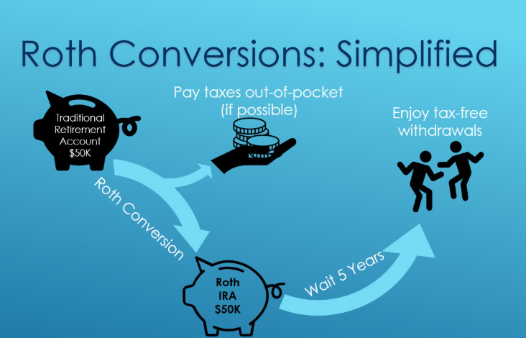

Slide 38
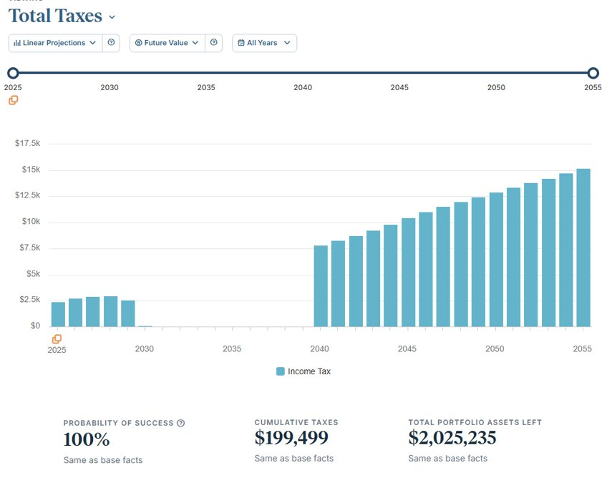
To Convert or Not to Convert…..
Notes:
Are you in a lower bracket now than in future?
Lower bracket than beneficiaries?
Do you think taxes are going up?
Do you have a spouse?

Slide 39
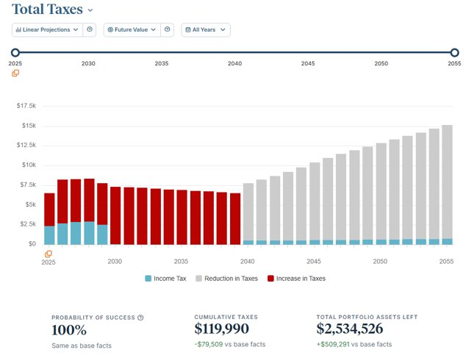
To Convert or Not to Convert…..

Slide 40
Checklist
Are your assets set up to pass efficiently from you to your spouse? The next generation?
Do you have an IRA exit strategy?
Is your plan currently set up for an unexpected death of a spouse?
Is your Financial plan currently taking advantage of TCJA (sunsets in 2026)?
Have you preformed any tax planning to avoid excess death taxes?

Slide 41
Next Steps:
Power Play: Complimentary Meeting
Notes:
The fact is these tax maps look completely different depending on your specific situation. Schedule an appointment within the next two weeks and we’ll create a custom tax-map and report based on your situation at no charge.

Slide 42
*Insert logo
*Insert picture of building
Get in touch with us
*Insert phone number
*Insert address
*Insert email
*Insert picture of team
Notes:
If this is the kind of advice you are looking for – then we may be the firm for you. If you would like to take advantage of our office and talk with us 1 on 1 just click the link and pick a day and time that works for you. One of our team will give you a call. We will start with a retirement report card and tax analysis to determine if there are opportunities to save you $$ this is completely complimentary and we would love to show you how this type of planning can benefit you and your family. I hope this was different that what you expected! We are short on time so I won’t be able to get to all the questions but I’ll grab a few here. Any questions we don’t get to here – I WILL get back to you this WEEK with an answer.
Have a great evening! I look forward to talking with you 1 on 1 soon.

