Slide 1

Taxes/Retirement Supplemental Slides

Slide 2

Taxes/Retirement Supplemental Slides
Notes:
Number one expense. Control what we can control to max what you have worked so hard to save.

Slide 3
Q1:
In what year was Social Security established?
1935

Slide 4
Q1:
In what year was Social Security established?
1935
Q2:
In the beginning, how many workers contributed to the Social Security for every one person who took out?
42:1

Slide 5
Q1:
In what year was Social Security established?
1935
Q2:
In the beginning, how many workers contributed to the Social Security for every one person who took out?
42:1
Q3:
How old did you have to be to draw on Social Security in 1935?
65

Slide 6
Q1:
In what year was Social Security established?
1935
Q2:
In the beginning, how many workers contributed to the Social Security for every one person who took out?
42:1
Q3:
How old did you have to be to draw on Social Security in 1935?
65
Q4:
What was the average life expectancy in 1935?
62

Slide 7
Q1:
In what year was Social Security established?
1935
Q2:
In the beginning, how many workers contributed to the Social Security for every one person who took out?
42:1
Q3:
How old did you have to be to draw on Social Security in 1935?
65
Q4:
What was the average life expectancy in 1935?
62
Q5:
If you made it to 65, how long did you draw on Social Security before dying?
2 years

Slide 8
Q6:
Today, how many workers contribute for every one person that takes out?
3:1

Slide 9
Q6:
Today, how many workers contribute for every one person that takes out?
3:1
Q7:
What will that ratio look like in 10 years?
2:1

Slide 10
Q6:
Today, how many workers contribute for every one person that takes out?
3:1
Q7:
What will that ratio look like in 10 years?
2:1
Q8:
What’s the earliest age you can draw on Social Security today?
62

Slide 11
Q6:
Today, how many workers contribute for every one person that takes out?
3:1
Q7:
What will that ratio look like in 10 years?
2:1
Q8:
What’s the earliest age you can draw on Social Security today?
62
Q9:
If you begin drawing at 62, how long will you receive benefits, on average, before you die?
23 years

Slide 12


Slide 13
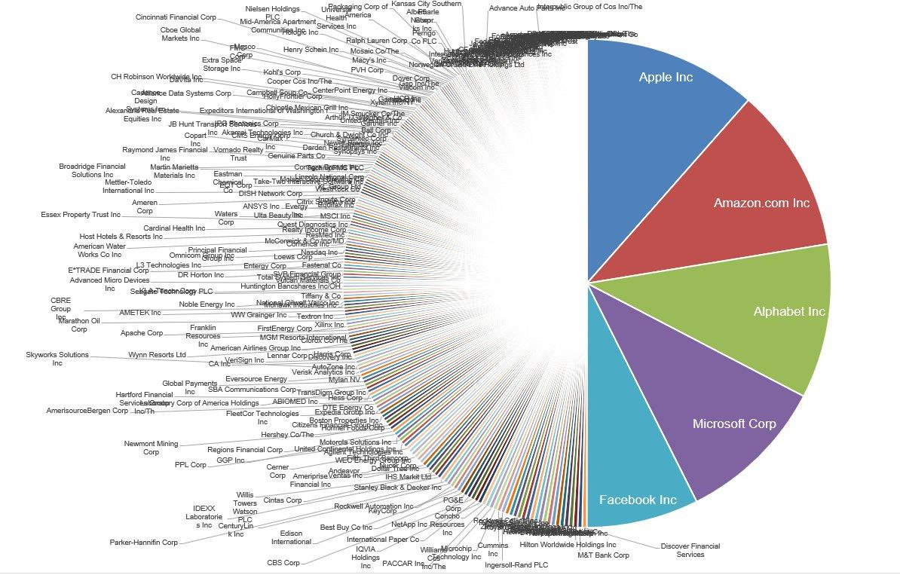

Slide 14
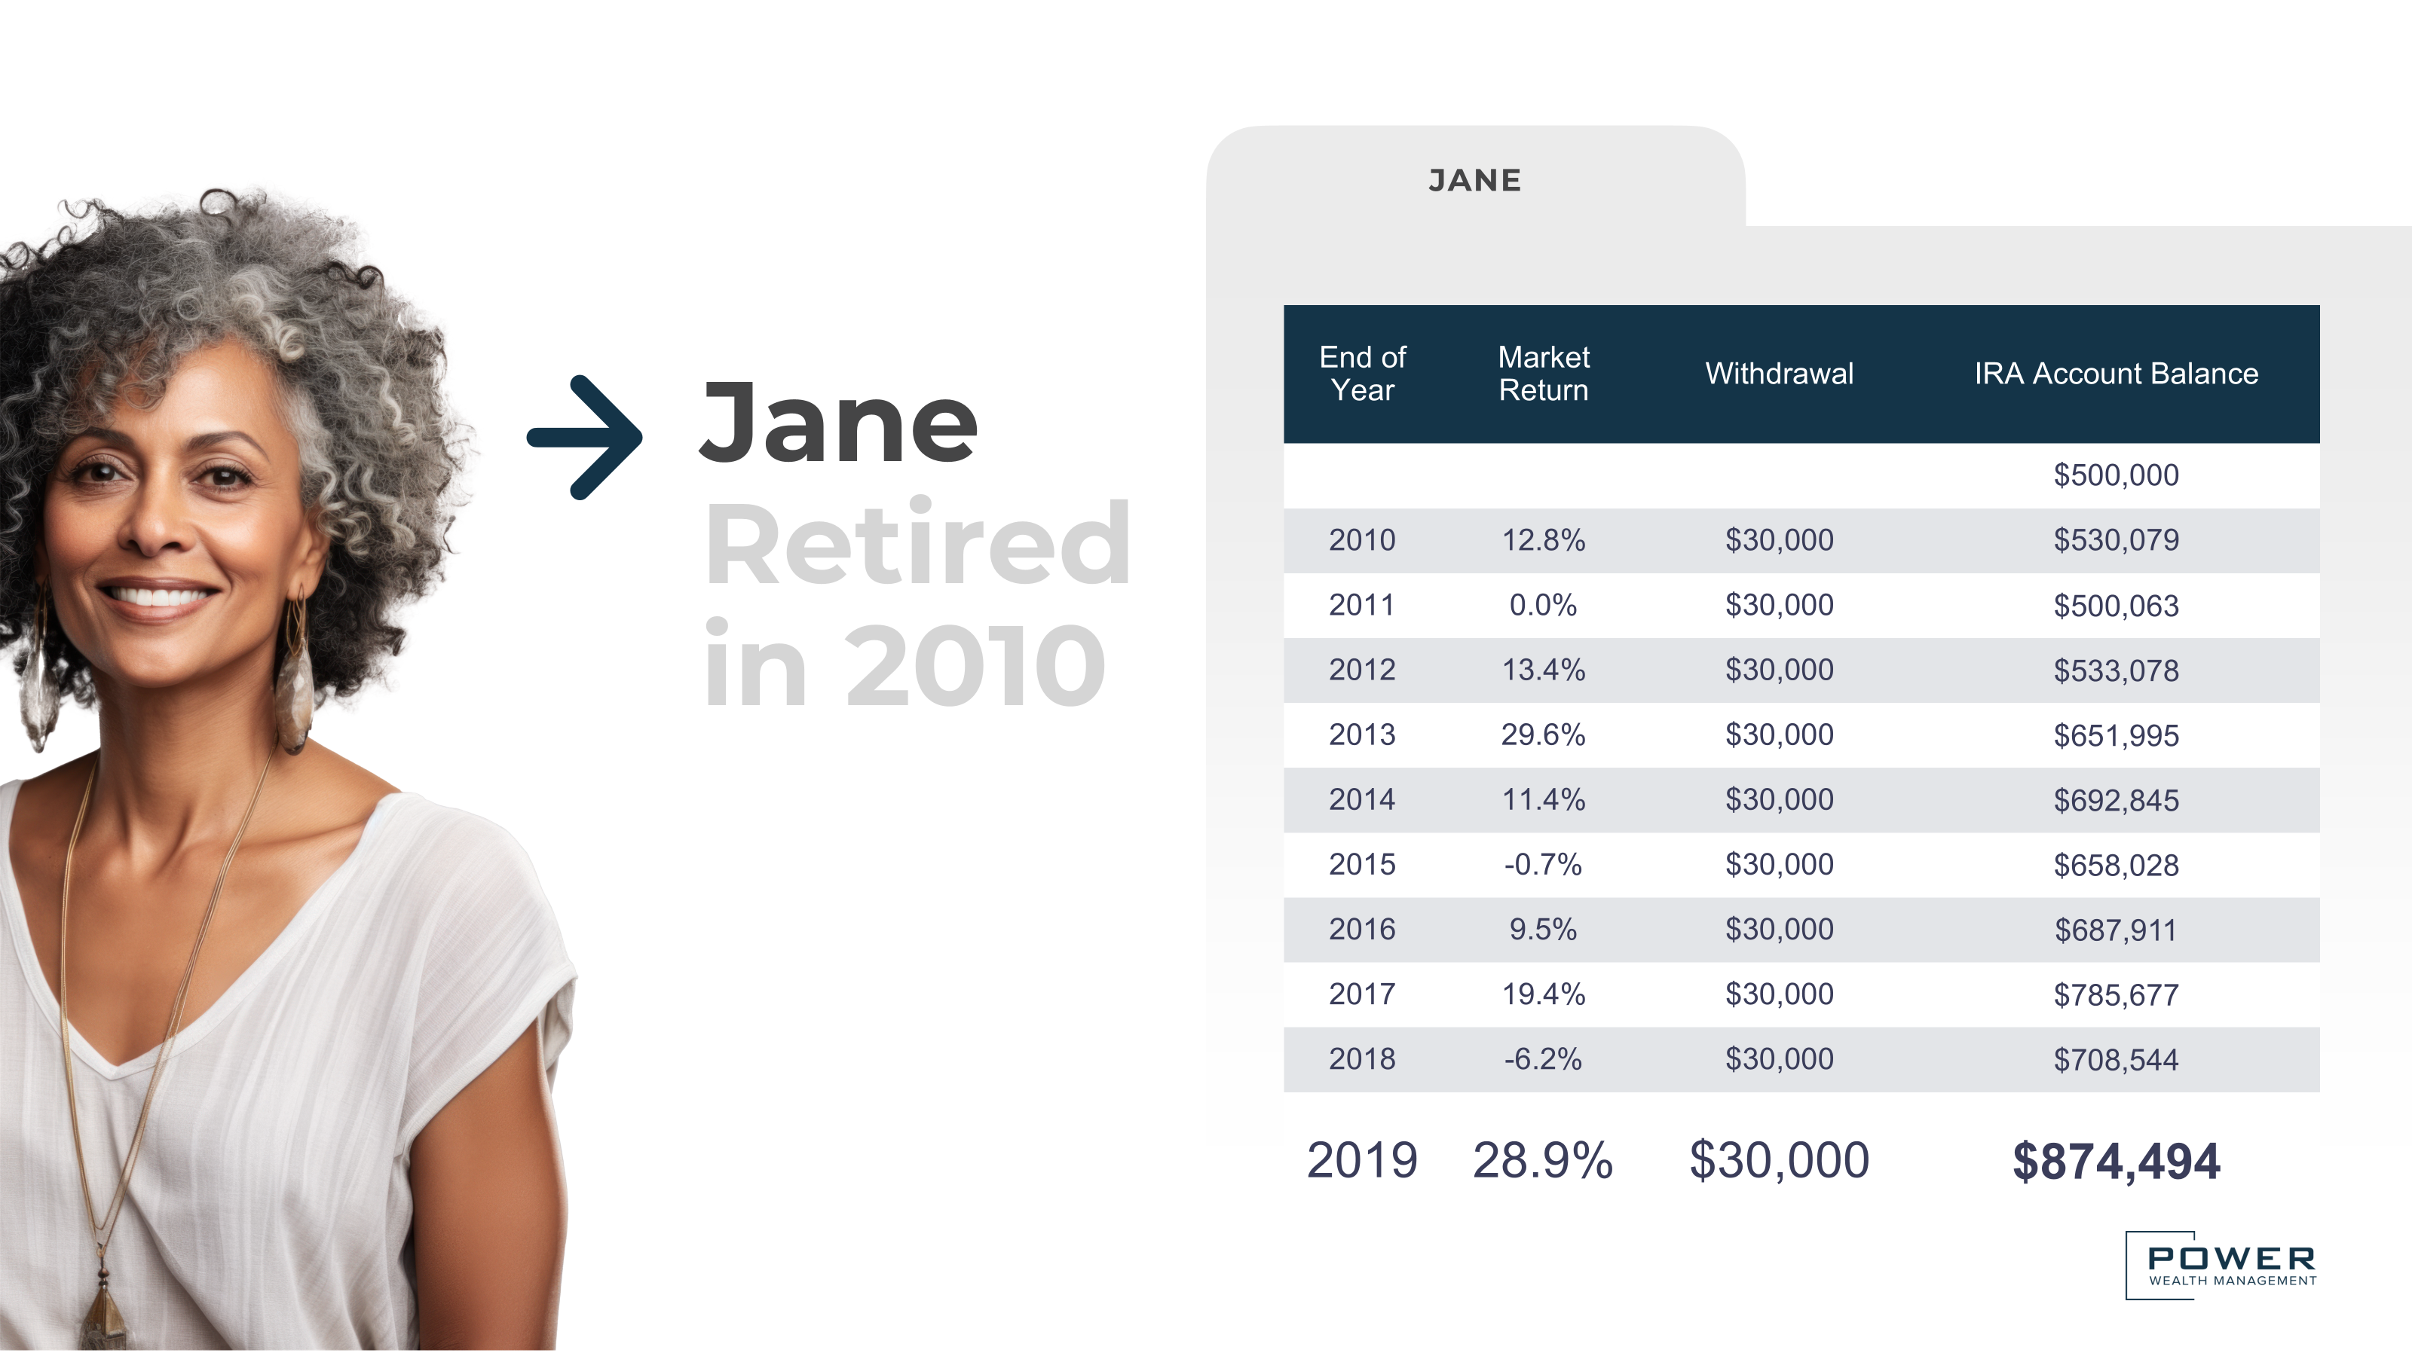

Slide 15
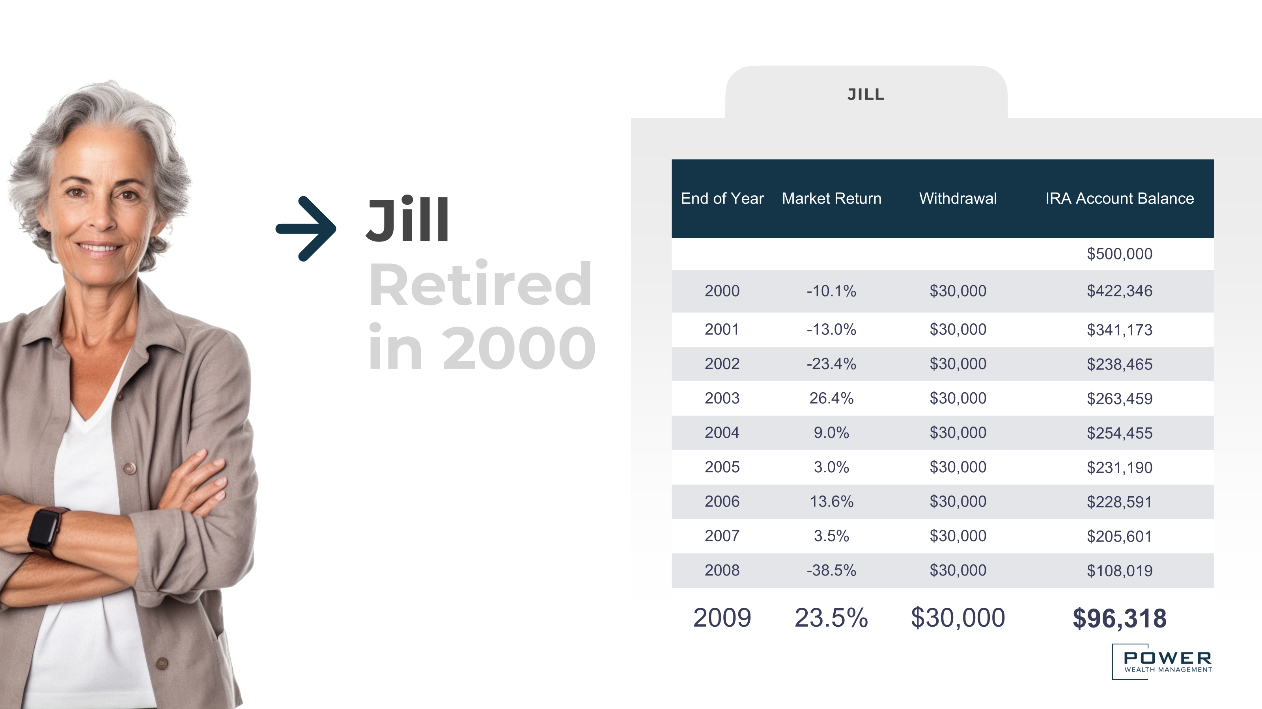

Slide 16
Why Asset Location Matters
0.41%
15%
$8.2k+
Annual Boost
Long-term Impact
Dollar Savings Per Year
Potential return increase from optimal asset location
Potential portfolio growth over 20 years
Potential tax savings on a $2M portfolio
Asset location can significantly impact your after-tax returns. The strategy creates more wealth without taking additional investment risk.
Source: Charles Schwab https://www.schwab.com/learn/story/how-asset-location-can-help-save-on-taxes

Slide 17
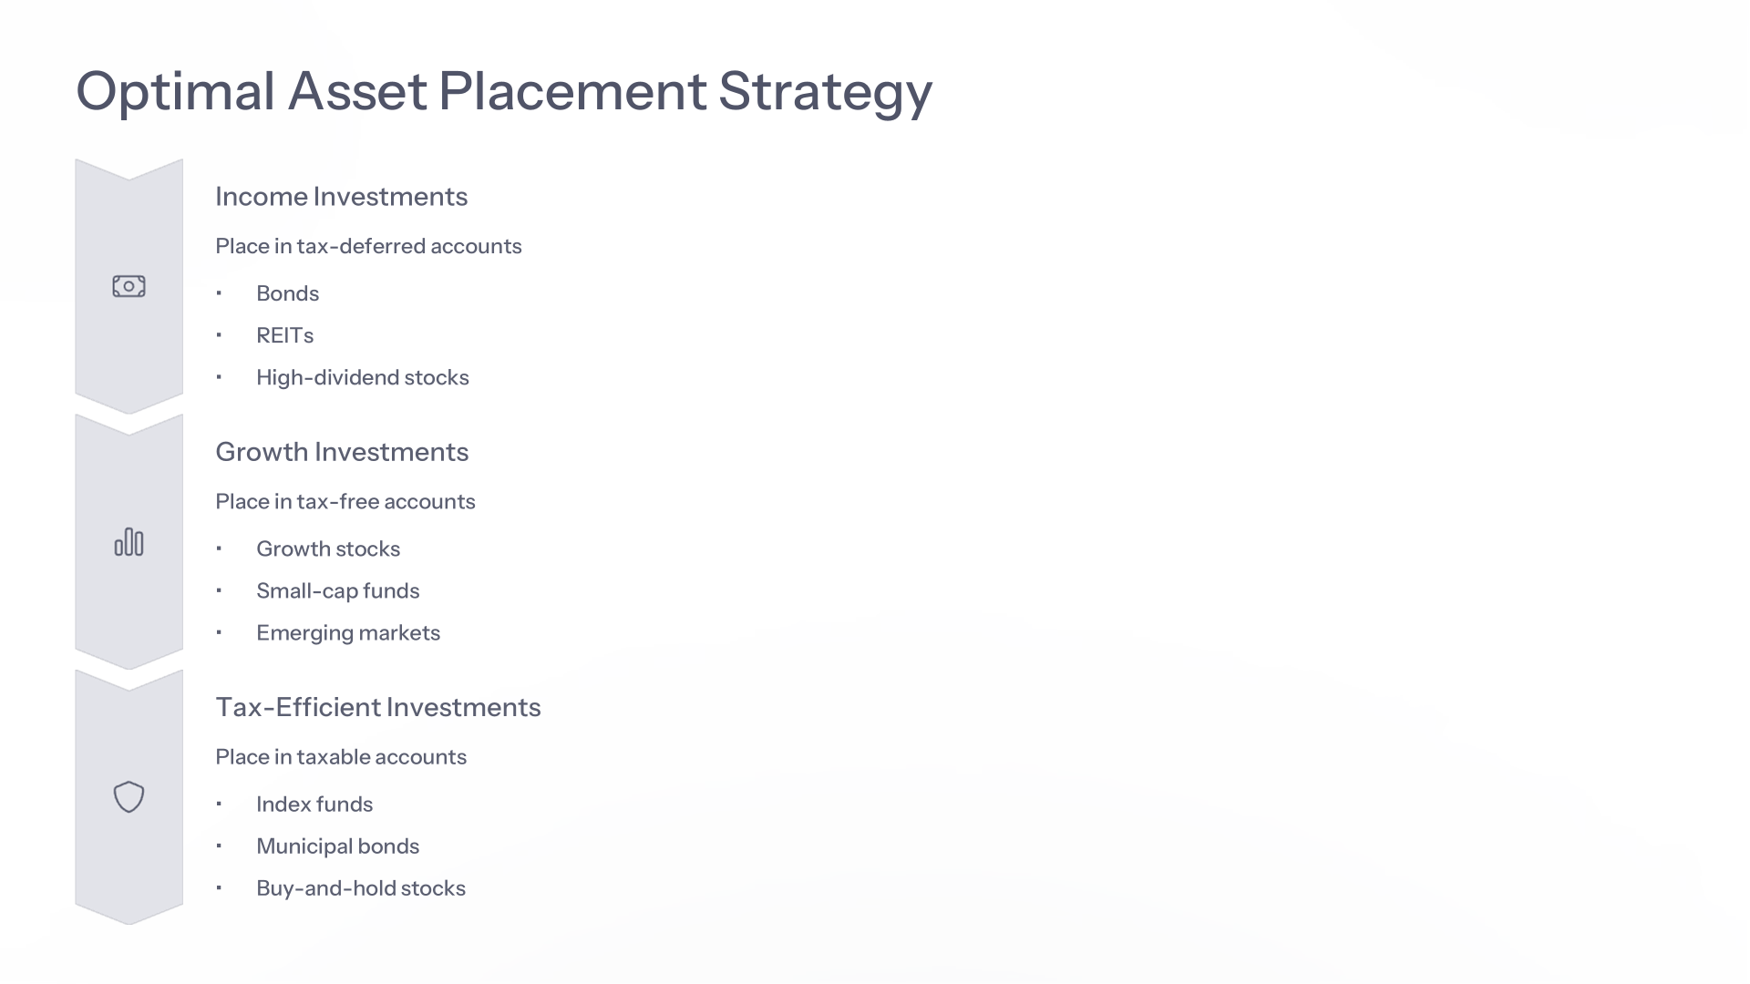



Optimal Asset Placement Strategy
Income Investments
Place in tax-deferred accounts
Bonds
REITs
High-dividend stocks
Growth Investments
Place in tax-free accounts
Growth stocks
Small-cap funds
Emerging markets
Tax-Efficient Investments
Place in taxable accounts
Index funds
Municipal bonds
Buy-and-hold stocks

